Slide 1
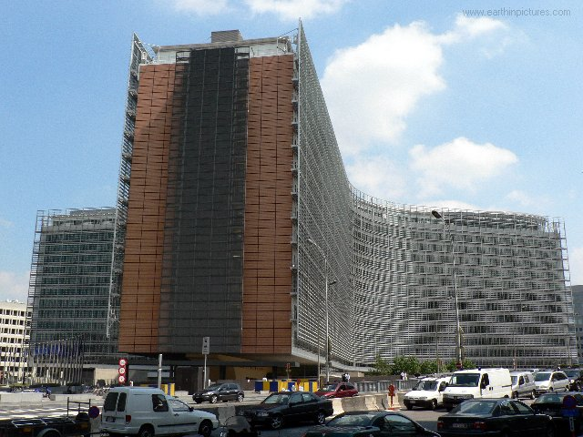
Precise but Vague: The European Commission and its Educational interventions: 2007-2022
Dr Peter Gray
Phereclos “Lay of the Land” conference, Bucharest, September 2022
graypb@gmail.com

Slide 2
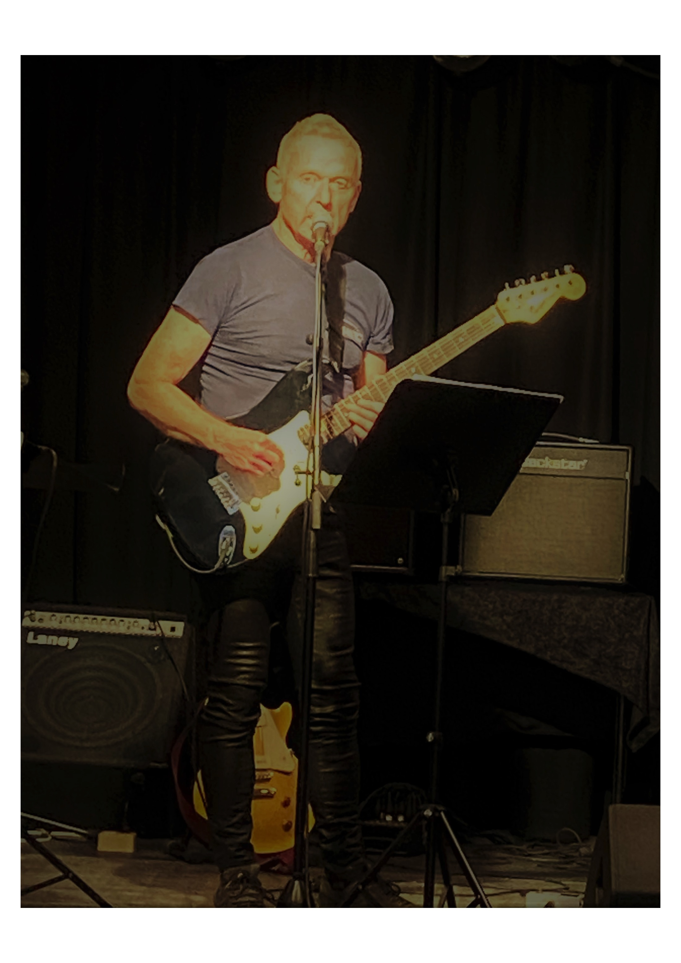
Who am I?
Involved in EU projects since 2002
Project manager S-TEAM (Science-Teacher Education Advanced Methods) 2009-2012
European Projects Adviser, Norwegian University of Science and Technology, 2012-2022
EC Evaluator/Rapporteur 2014-2020

Slide 3
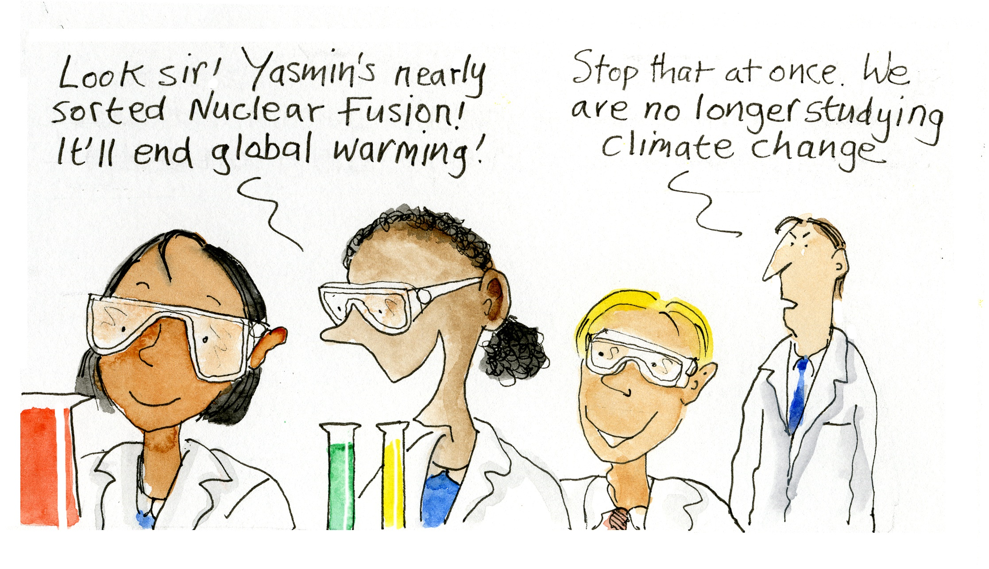

Slide 4


Slide 5

Precise but Vague
Precision: an engineering term
Vague: anything to do with people
EU projects in education are supposed to provide precise answers to vague questions
An expression applied to Evaluation Sunmary Reports (ESRs)

Slide 6

Some familiar terms?
Inquiry based science education
Mobilisation and Mutual Learning Actions
Responsible Research and Innovation
Citizen Science
Open Science
Open Schooling

Slide 7
Quick quiz (1)
How many of you have been involved with projects in:
Inquiry based science education?
Mobilization and Mutual Learning?
Responsible research and Innovation?
Open Schooling?

Slide 8
Quick Quiz (2)
How many funded EU projects have you been involved in?
How many FP7/H2020/Horizon Europe proposals have you been involved in?
How many EU-funded projects can you name?

Slide 9
Desired Long term Impacts (EC)
More school leavers entering STEM careers
Better gender balance/diversity/inclusion in STEM
Increased scientific literacy in general population
Enhanced relationship between research and innovation ecosystems and society in general

Slide 10
Methods
Better student engagement with STEM subjects through:
  Authentic, contextualised activities
  Increased range of resources and pedagogies for teachers
  Involvement of external actors

Slide 11
Precise Impacts Quiz
Number of Additional School Leavers taking up STEM careers as a result of your project?
What’s wrong with the question?

Slide 12
Precise Impacts Quiz (2)
Number of Community/School Initiatives solving real world problems during lifetime of project?

Slide 13
Precise Impacts Quiz (3)
Increase in Gender balance within STEM disciplines/careers?

Slide 14
Variables beyond our control?
Financial Crisis 2007-2008
Shifts in national education policy, especially the focus on standardised testing
Russian invasion of Ukraine
Climate Change

Slide 15
Too little, too late
Scientists are as guilty as anyone else
Science is always relevant in its own worldview i.e it is not usually reflexive
Ship of Fools

Slide 16
Three hypotheses
Targeting primary school children to feed the STEM pipeline is ineffective
Bringing mature/vocational students into STEM would be more effective
Shortage of science teachers does not equal shortage of scientists

Slide 17
Four More Hypotheses
Career choices are not one-time decisions made whilst at school
Science/STEM careers are often badly rewarded in comparison to other areas
Science has far less influence over climate change than economics/politic/laws
Vocational Education and Training is a more fertile ground for STEM activity than University

Slide 18
Why Science Capital?
Science Capital – taking on the negative features of science
A sense of belonging – but this can exclude as well as include
Too much focus on a flawed university system

Slide 19
Does Europe Really need more scientists?
Lack of coherent research on labour market needs
For Corporate profit or public good?
Failure of RRI to have real impact on direction or outcomes of research and innovation
Brexit illustrates lack of understanding of labour market at government level

Slide 20
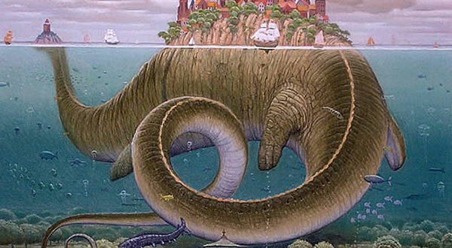
What can we gain from an archaeology of EU projects in education?

Slide 21
OStogether
Evaluation and inspiration

Slide 22
Commonalities
Policy Recommendations
Platforms
Barriers to uptake
Difficulties of post-project evaluation
Rooted in EC policy obsessions/fashions

Slide 23
Long-term outcomes
Common platform, or post-project platforms?
Common policy recommendations
Common, continuing evaluation of impact
Continuing commitment of EC to open schooling, or to broader school reform
Expansion beyond narrow concerns about STEM labour market
Education for Students, not for the Curriculum

Slide 24
Call and Anti-call
Calls based on hypotheses but not on evidence
Need for agreement on the problem before defining the solution
Opening the possibility of alternative approaches

Slide 25

The End
Thanks for listening!
Mulțumesc pentru ascultare!
graypb@gmail.com

