Slide 1
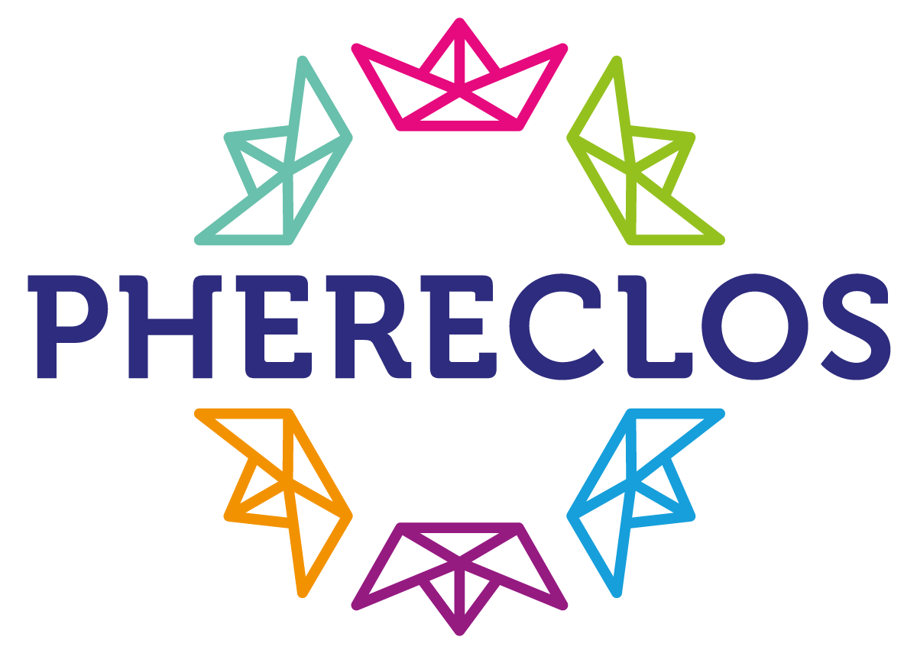
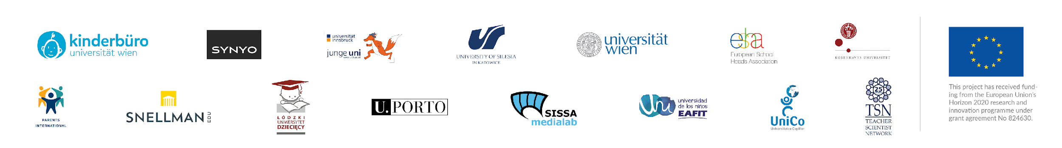
PHERECLOS in a nutshell
The project basics …
“Lay of the Land” Conference
Bucharest, RO - Sept 8th, 2022

Slide 2
The project basics

Slide 3
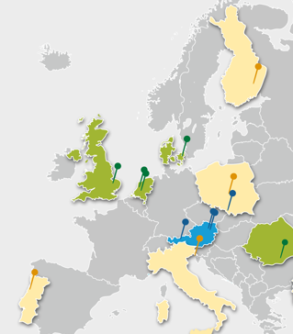

Who we are – The project Consortium …
15 Partners …
10 Countries …
Vienna University Children’s Office – Austria – Coordinator
SYNYO GmbH - Austria – Technical Background
Universität Innsbruck – Austria – Knowledge platform, good practise library
Uniwersytet Slaski – Poland – Transnational Mentoring Partnerships
Universität Wien – Austria – Implementation Studies
Universitatea Copiilor – Romania – Dissemination & Children’s Perspective
European School Heads Association - Netherlands - School heads’ perspective
International Parents Alliance – Netherlands – Parents’ perspective
Teacher Scientist Network – United Kingdom – Teachers’/Training perspective
Kobenhavns Universitet – Denmark – Teachers’/Training perspective
Snellman-instituutti – Finland – LEC Kuopio
Politechnika Łódzka – Poland – LEC Łodz
Universidade do Porto – Portugal – LEC Porto
S.I.S.S.A. Medialab - Italy – LEC Trieste
Universidad EAFIT – Colombia – LEC Medellin
Vienna University Children’s Office – Austria – LEC Vienna

Slide 4
The PHERCLOS approach …

Slide 5
Phereclos is based upon 3 ideas
- The conceptual framework -
Science Capital
goes back to Pierre Bourdieu’ cultural theories - underlines aspects of social inclusion
Children’s Universities
the proven idea of Children’s Universities as intermediaries between various parties in the Third Mission of universities - and incubators for the opening of universities towards the public and for promoting educational opportunities
“The concept of science capital is a way of encapsulating all the science-related knowledge, attitudes, experiences and social contacts that an individual may have. [It] helps to understand that science is important for improving life chances, equity and success of all young people.”
(Archer, L. et.al. 2015)
Science Capital
Children’s Universities
Open Schooling
Open Schooling
the understanding of an Open School culture as a model of how schools can better reflect on societal ideas, topics and challenges through external cooperation and a way to show the key role of schools in our society

Slide 6

The overall aims
The overall aim of PHERECLOS was:
to develop models and recommendations for new ecosystems in education (LEC) (in and around schools)
based on innovative collaboration across the sectors (formal – non-formal, ALL different stakeholders)
to support schools to become hubs of innovation and STEM engagement in a community
to build upon the experience of Children’s Universities as “incubators of change”
to link science engagement with practical experience and real life (Science Capital!)

Slide 7
Main elements of activities
establish Local Education Clusters (LEC) as experimental testbeds for educational cooperation in 6 model regions
set up 10 cross-sectoral Transnational Education Mentoring Partnerships (TEMPs) between differently experienced parties in formal/non-formal areas
Academic transfer- and implementation analysis and advocacy counselling will inform the implementation of the PHERECLOS approach (LECs, TEMPs)
Capturing the learning through an annotated Good Practise Library, a White Book on Open Schooling, Policy Recommendations and Advocacy Toolkits as well as a Teacher Training Innovation Toolkit

Slide 8
What is a Local Education Cluster?
A Local Education Cluster is:
an innovative model of collaboration in education
which includes a diverse spectrum of knowledge providers and other stakeholders
who have committed to a joint work programme to be established as a pilot initiative
continuously informed by various tools and methods provided by academic implementation studies and theories
with the aim to implement this initiative as a permanent platform for collaboration

Slide 9
Why is this important?

Slide 10


Slide 11
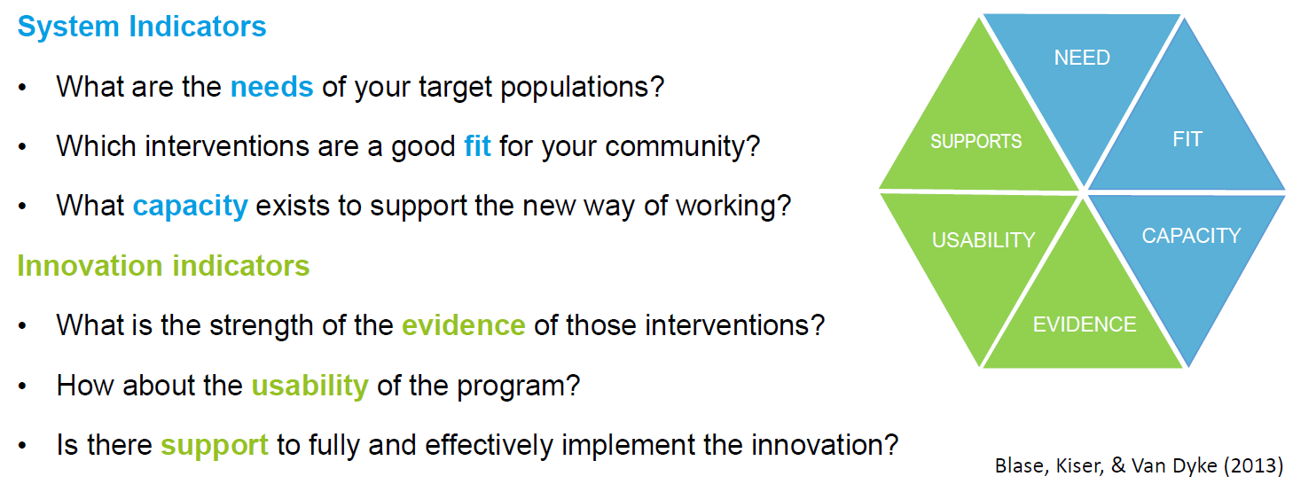

The Hexagon Model

Slide 12
The PHERCLOS achievements …

Slide 13
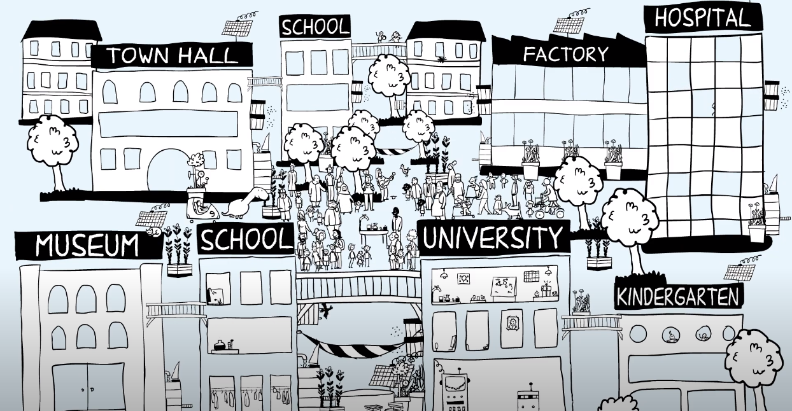
214 Schools
38 Governmental Organ.
36 Business/ Industry
355 entities IN TOTAL
33 NPOs
34 Universities

Slide 14
9.636 children
33 policy makers
1.381 teachers and teacher training students
2.456 parents
494 researchers

Slide 15
What have we learned from the LEC implementation?
The Sustained Modelling and Scenario Building Reference Guide

Slide 16
Questions:
TRIESTE: Your main idea was: “build a new network of keyplayers for science engagement – including teachers” Does this work in times of the pandemic? What was your most important learning from this?
MEDELLIN: Your LEC was built upon the idea that children are heard as citizens – using the methodology of “Co-design”. Where did you start 3 years ago and where are you now?
PORTO: You are running one of the big Children’s Universities in Europe in Porto! What was new for you and how did the collaboration with schools influence your Children’s Universities?
VIENNA: In your LEC, social inclusion and “hard to reach groups” were key words! How would you describe the outcome of your LEC and what are the visible changes both in school and in university?
LODZ: The very special element of your LEC is the participatory approach! Young people designed their own conferences – What were the reactions of universities and schools to this approach?

Slide 17
Insights and Outcomes

Slide 18
Insights and Outcomes

Slide 19
The 12 Factors of Success
Common motivation is the starting point
Giving opportunities not solutions, more listening than knowing in advance is the attitude
Co-creation is the way
Teachers are the key
Openness to the unplannable and flexibility brings everything into flow
Diversity and inclusion of everybody is the glue
Caring culture brings coordination and structure
Activation and engagement builds capacity
Local action opens new spaces for thoughts
Critical mass gives weight
Innovation, common understanding and enthusiasm are the engine
Knowledge on implementation and advocacy supports sustainability and growing

Slide 20
How can the OS approach be scaled up and experience be shared?
The PHERECLOS Mentoring Programme

Slide 21
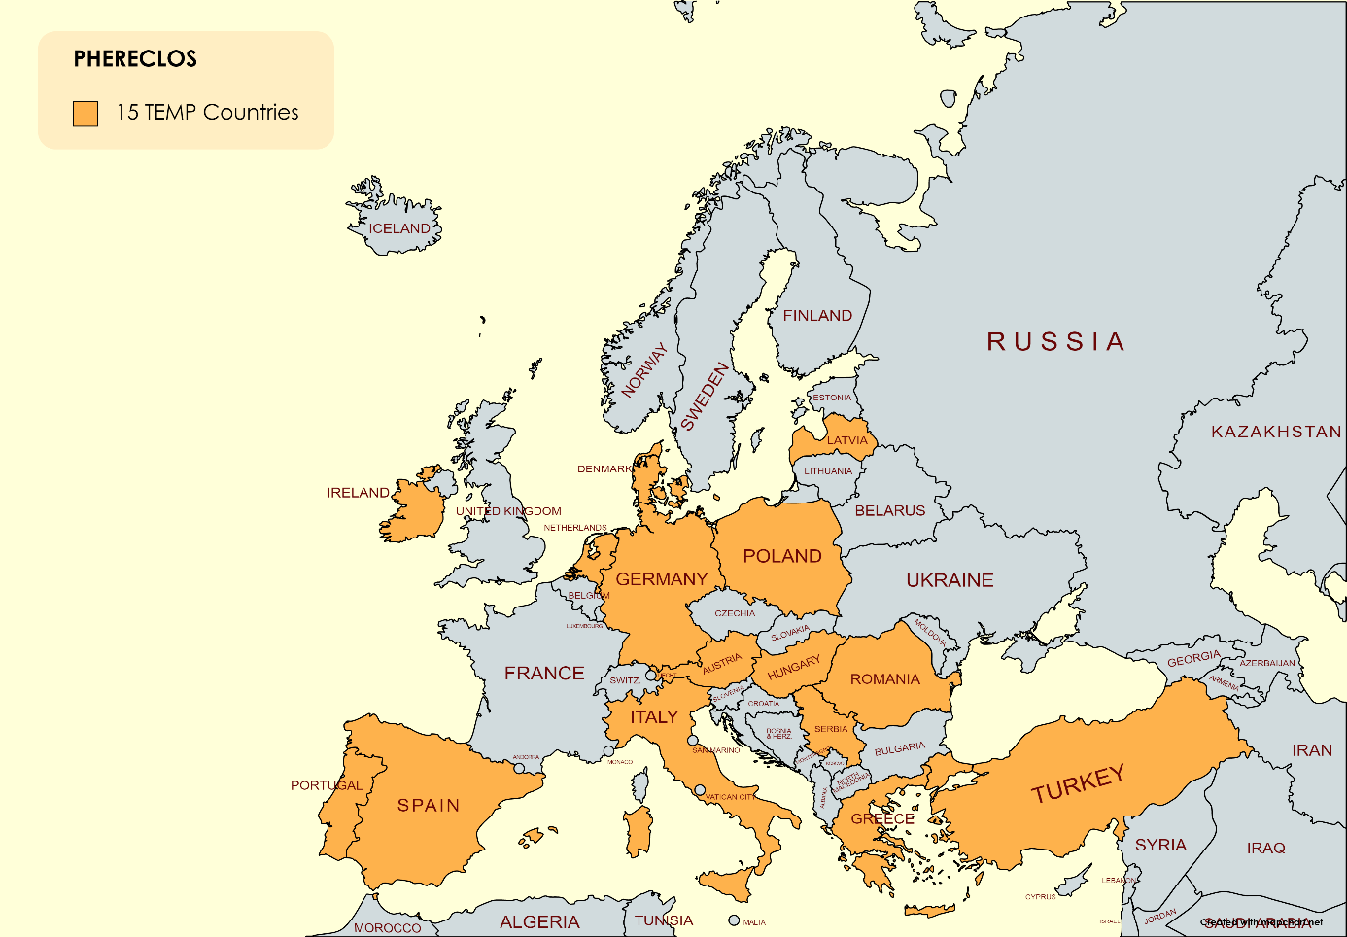
Insights and Outcomes
TEMPs’ location in Europe.
The PHERECLOS project consortium consists
of 15 partners located in 10 countries - 9 European countries and Colombia.
LECs Local Education Clusters are located and operate in 5 European countries and Colombia.
TEMP partnerships – 44 partners are located and operate in 15 European countries.
8 of them are new countries like, among others, Germany, Spain, Greece, and Turkey, that have joined the project in this way.

Slide 22
Questions:
You heard about the 12 factors of success of Local Education Clusters! Are there some factors, which are relevant outcomes of the learning of the Transnational Partnerships?
The Venice model is one of building bridges between different islands. Do you think, that the TEMPS also build such bridges?
How has the programme helped to trigger new initiatives and to share the learning about OS? Can you mention some examples?

Slide 23
What are the implications of OS and what is the potential for Teacher Training?
The Teacher Training Innovation Toolkit on Open Schooling

Slide 24
Insights and Outcomes

Slide 25
Questions:
One of the factors of success is: “Teachers are the key!” – Do you agree and what is needed, that they can be the key?
What can the Teacher Training Innovation Toolkit on Open Schooling contribute to this?
In brief, what is the potential of Open Schooling in teaching scenarios? What do teachers need to know?
How can interested parties make use of the toolkit?

Slide 26
Where does policy come in and how to advocate for it?
The Policy Recommendations & the Advocacy Toolkit

Slide 27
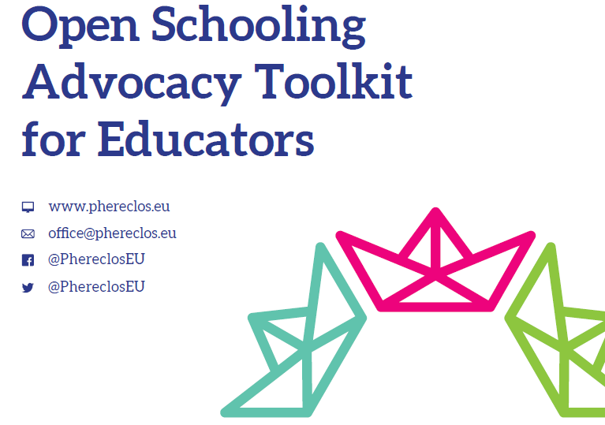
Insights and Outcomes

Slide 28
Questions:
Why is advocacy relevant for open schooling?
You worked on a Advocacy toolkit. How can practitioners make use of the advocacy toolkit?
We already heard about the key activities of PHERECLOS on a local and on a Transnational level! What is the difference between local and international policy work, and which part of the work is more efficient and powerful?
Policy work reminds us a little bit like strategic planning of a ship tour, including instruments to influence captains decisions. What are the main recommendations for policy on this new journey towards Open Schooling?

Slide 29
What is the legacy of the PHERECLOS project?
The PHERECLOS White Book on Open Schooling

Slide 30
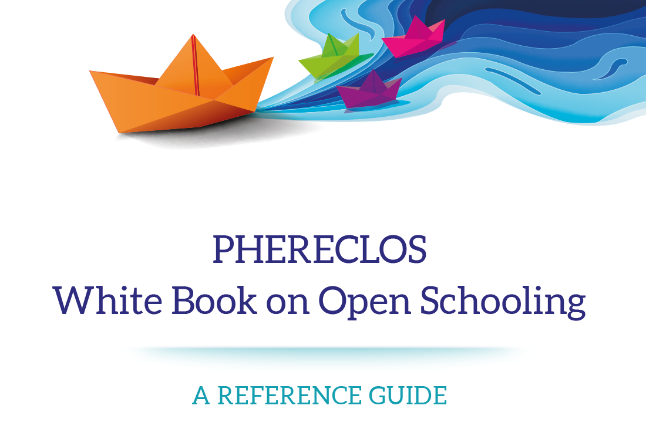
Insights and Outcomes

Slide 31
Questions:
What is the purpose of the Whitebook on Open Schooling? (Silvia)
You worked like a cruise writer or a travel reporter and joined the team in the last chapter of the journey. After compiling the chapters of the White book, how would you describe the “PHERECLOS ship”? (Karen)
Just as important as the product - the Whitebook - is the moment when it is published. And that is this conference! When you look at the programme and the audience – do you think reached the final harbor? Or do you see some islands to explore? (Laura)

Slide 32
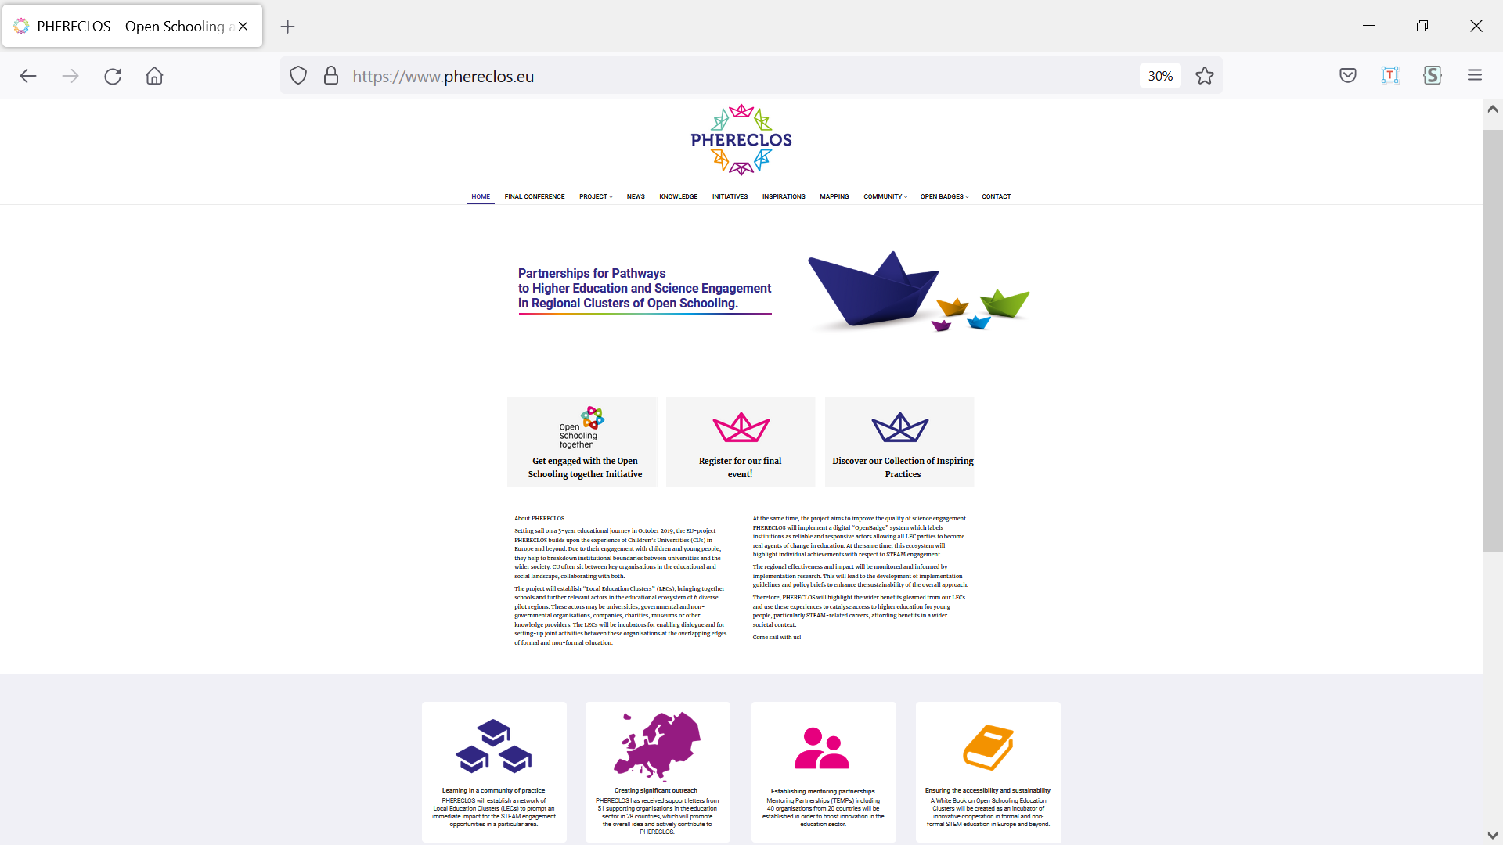
Insights and Outcomes

Slide 33
