Slide 1

The full story
In short time

Slide 2

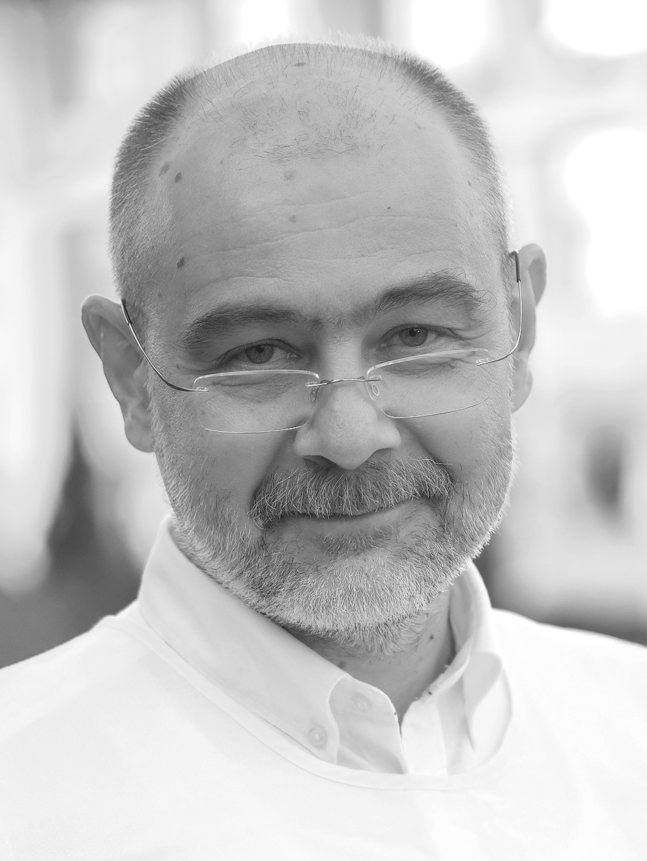


Alexandru Toma Pătraşcu
Festival Director
toma@BucharestScienceFestival.ro
+40 788 39 25 39
Notes:
01. Positioning schools at the center of community wellbeing
Make it Open aims to make the first step towards transforming schools from traditional educational institutions into community partnerships where learning responds to both learners and community needs. Having parents and other informal actors as learners and supporters will empower schools to make a positive impact on their environment. By actively involving professionals from enterprises and civil society and non-formal organizations, we will bring real-life projects into schools and we will foster the importance of science learning for community well-being.
02. Introducing maker education and citizen science as a transformative approach for open schooling:
Make it Open will introduce maker education, citizen science and the constructionism learning as the three “transformational approaches” to teaching and learning STEAM. The project will use a holistic approach where students, educators, parents and different actors in the community come together to reshape learning through tangible multidisciplinary projects. Make it Open will invite and encourage learners to see themselves as individuals who can ask, try, design, develop, test, iterate and take part in shaping (solutions for) the world they live in. Make it open will work towards creating and promoting multilayered learning processes, connecting formal, non-formal and informal science education to expand opportunities for open schooling.
03. Increasing the level of scientific literacy and interest in science of students and parents:
Make it Open will expand the level of scientific literacy of students and their families in ten countries, by making science more concrete, tangible, applicable and appealing. Students and their families will be invited to explore and participate in investigating real-world challenges from (and with) their communities by applying STEAM concepts and tools. Working on solutions to real challenges with experts, researchers, engineers, entrepreneurs and policy makers and visiting “real” working places, will expose students and families to wider spectrum of STEM based professions and can make STEM careers more accessible.
04. Mainstreaming open schooling:
10 open schooling hubs will support sharing, (co-)learning and the exchange of approaches and experiences around open schooling. This on-the-ground community will offer teachers’ training and continuous support in creating and implementing open schooling methodologies. It will invite policy makers and ministries of education to further discover, implement and support the concept in their countries. This ecosystem will strengthen open schooling and will develop a sustainable plan and legacy for local and European open schooling communities based on maker education and citizens science. A dedicated effort will be done to reach out other open schooling projects funded by the EC under this call in order to make use of each other’s networks, join forces in scaling up open schooling and leveraging on each other’s results

Slide 3
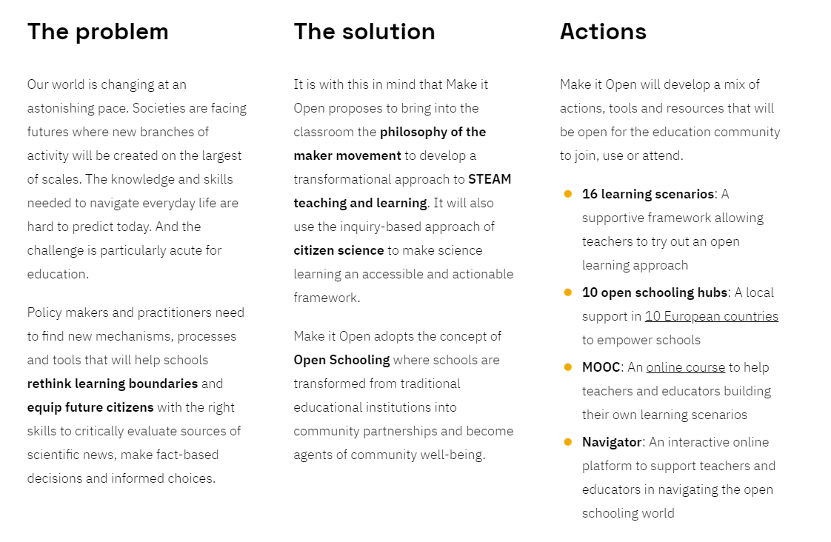
Source: https://makeitopen.eu/
Notes:
01. Positioning schools at the center of community wellbeing
Make it Open aims to make the first step towards transforming schools from traditional educational institutions into community partnerships where learning responds to both learners and community needs. Having parents and other informal actors as learners and supporters will empower schools to make a positive impact on their environment. By actively involving professionals from enterprises and civil society and non-formal organizations, we will bring real-life projects into schools and we will foster the importance of science learning for community well-being.
02. Introducing maker education and citizen science as a transformative approach for open schooling:
Make it Open will introduce maker education, citizen science and the constructionism learning as the three “transformational approaches” to teaching and learning STEAM. The project will use a holistic approach where students, educators, parents and different actors in the community come together to reshape learning through tangible multidisciplinary projects. Make it Open will invite and encourage learners to see themselves as individuals who can ask, try, design, develop, test, iterate and take part in shaping (solutions for) the world they live in. Make it open will work towards creating and promoting multilayered learning processes, connecting formal, non-formal and informal science education to expand opportunities for open schooling.
03. Increasing the level of scientific literacy and interest in science of students and parents:
Make it Open will expand the level of scientific literacy of students and their families in ten countries, by making science more concrete, tangible, applicable and appealing. Students and their families will be invited to explore and participate in investigating real-world challenges from (and with) their communities by applying STEAM concepts and tools. Working on solutions to real challenges with experts, researchers, engineers, entrepreneurs and policy makers and visiting “real” working places, will expose students and families to wider spectrum of STEM based professions and can make STEM careers more accessible.
04. Mainstreaming open schooling:
10 open schooling hubs will support sharing, (co-)learning and the exchange of approaches and experiences around open schooling. This on-the-ground community will offer teachers’ training and continuous support in creating and implementing open schooling methodologies. It will invite policy makers and ministries of education to further discover, implement and support the concept in their countries. This ecosystem will strengthen open schooling and will develop a sustainable plan and legacy for local and European open schooling communities based on maker education and citizens science. A dedicated effort will be done to reach out other open schooling projects funded by the EC under this call in order to make use of each other’s networks, join forces in scaling up open schooling and leveraging on each other’s results

Slide 4
make it open short summary
Make it Open is a gateway to open schooling where schools become key community actors and students perceive themselves as change makers.
The overall objective of Make it Open is to develop a sustainable infrastructure of open schooling in Europe, based on the approach, pedagogy, content, processes, and tools of the maker movement. The project stimulates innovative STEM activities
Notes:
I need to edit this

Slide 5
Objectives
1. Positioning schools at the centre of community wellbeing
2. Introducing maker education, citizen science and constructionism learning as the three “transformational approaches” to teaching and learning STEM.
3. Increasing the level of scientific literacy and interest in science of students and parents.
4. Mainstreaming open schooling.

Slide 6



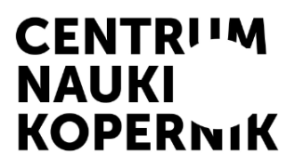
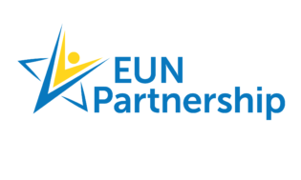






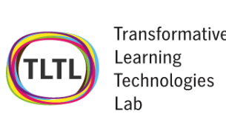

The partners
Practice Partners + OS Hubs | Networks + Academic | Third Parties – OS Hubs
 |  | .
 |  | .
 | . |  | .

Slide 7
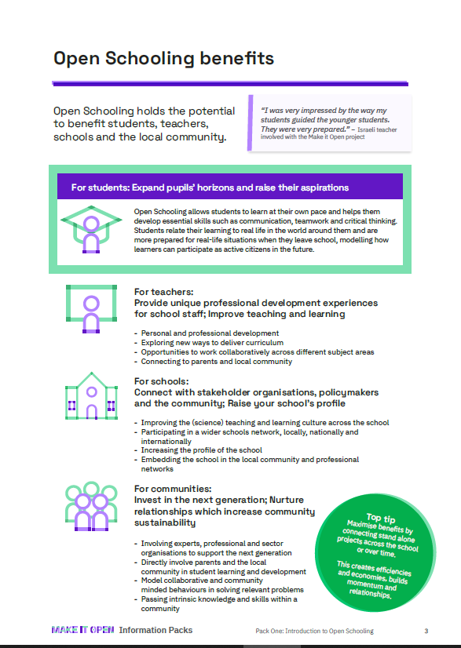
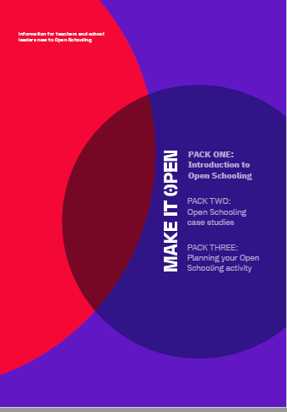
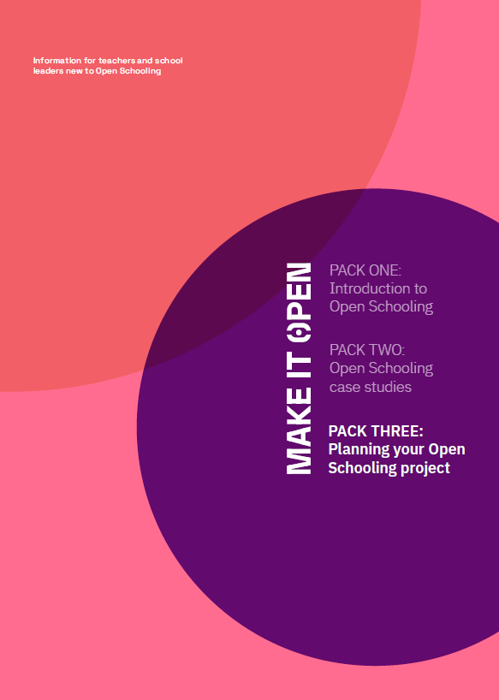
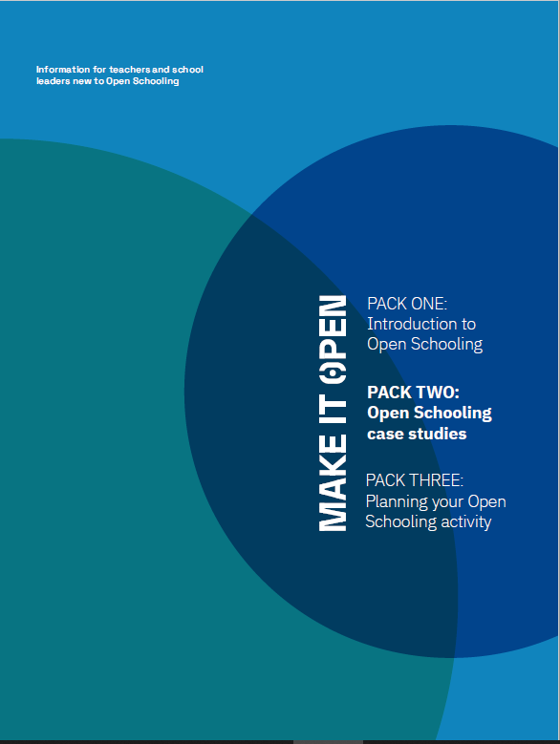
Open Schooling Information Packs

Slide 8




Co Design with Teachers
4 Practice Partners
8 schools
4 primary + 4 secondary
16 Learning Scenarios

Slide 9
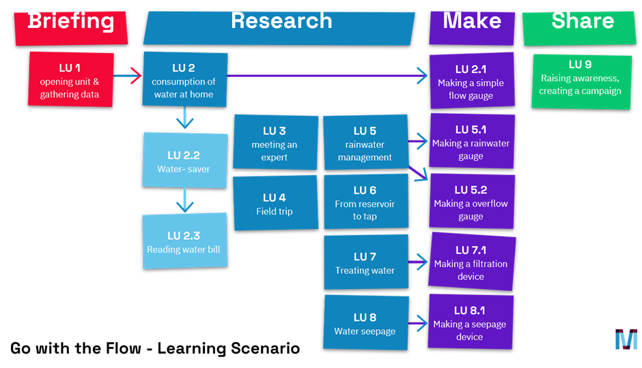
Develop and Iterate : Learning Scenario

Slide 10
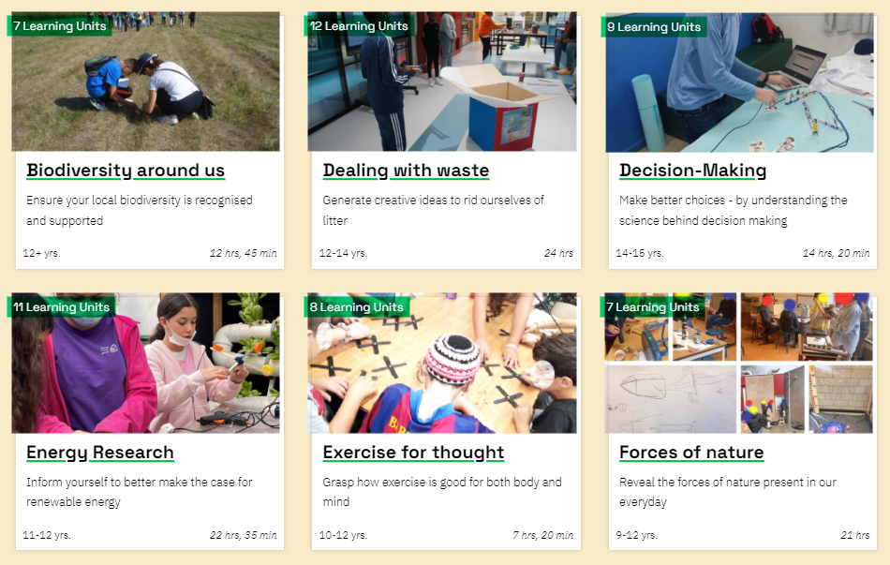
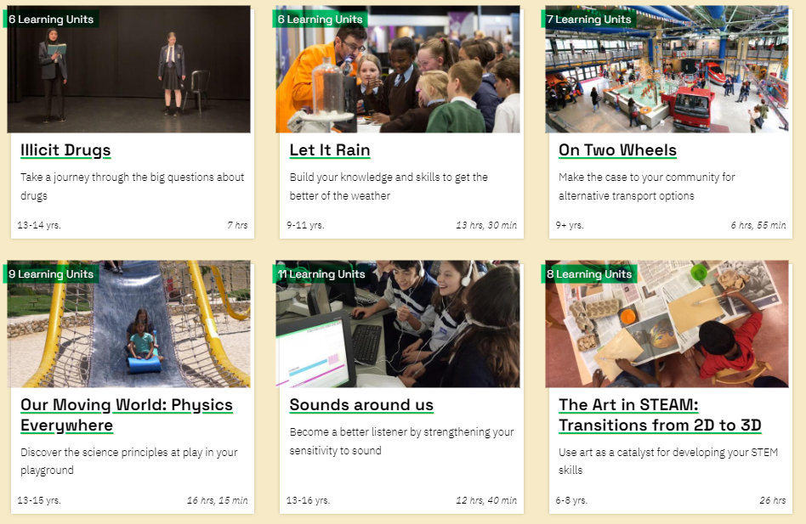
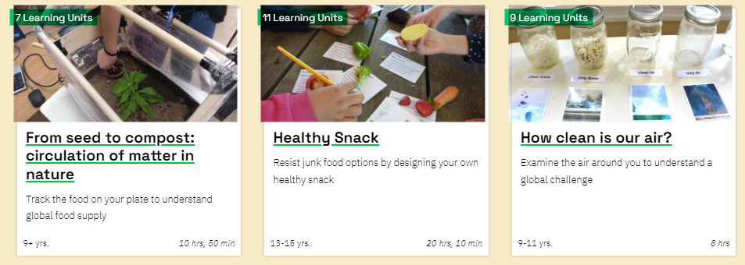
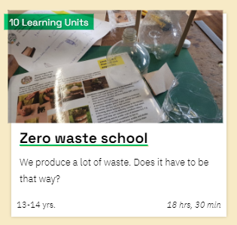
16 Open schooling Learning Scenario

Slide 11
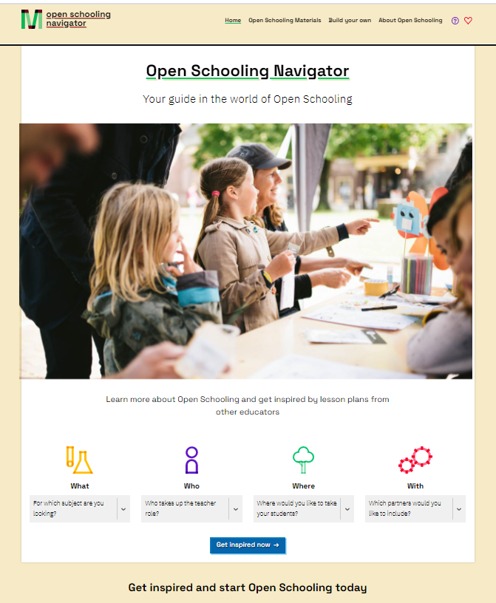
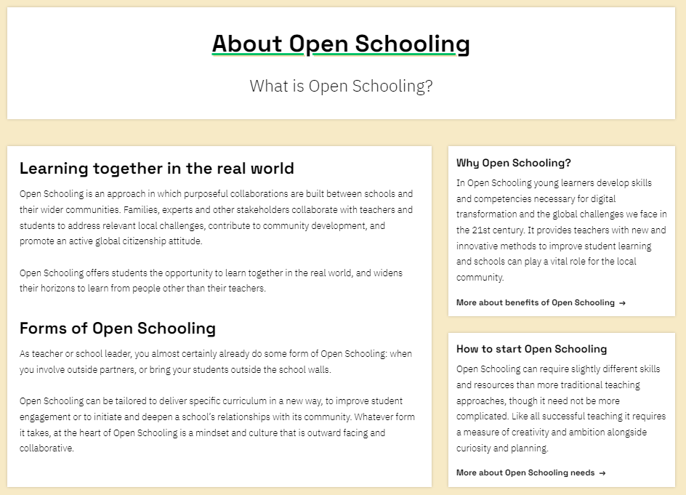
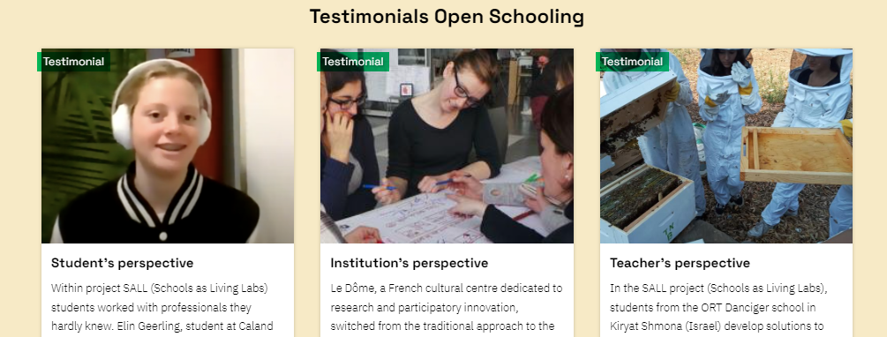
Integrate – the Navigator

Slide 12
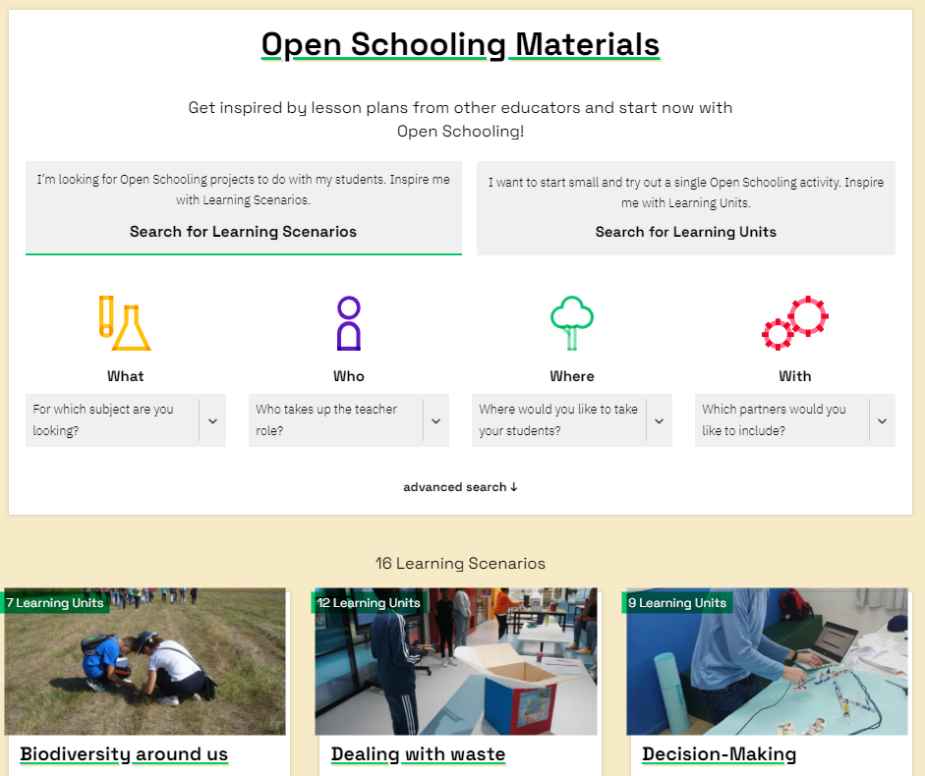
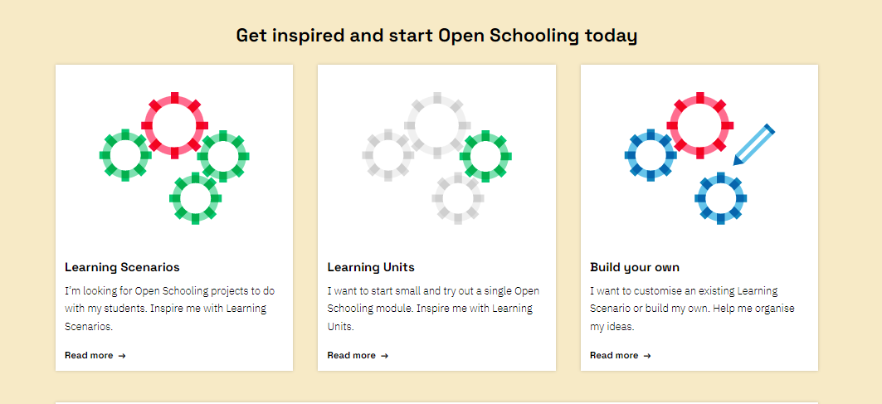
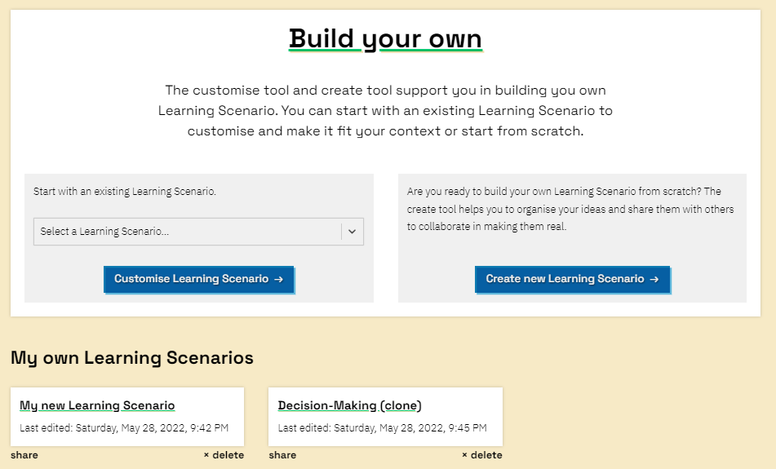
Integrate – the Navigator

Slide 13
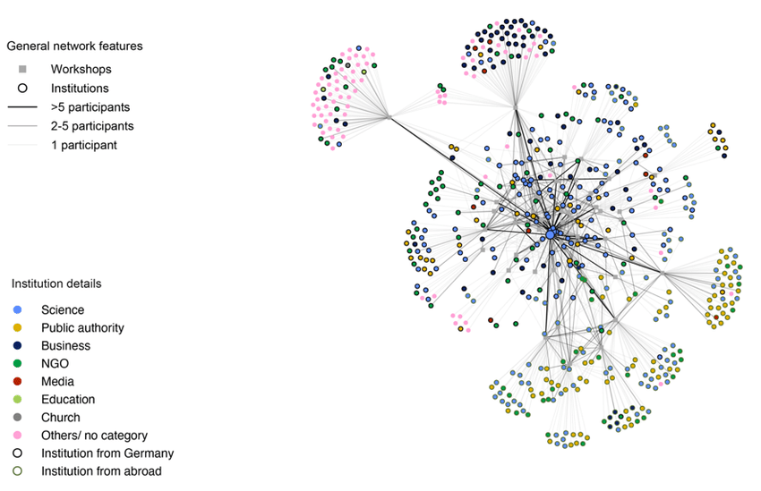

Support : 10 Open schooling Hubs
150 schools in Greece, Hungary, Israel, The Netherlands, Poland, Portugal, Romania, Spain, Sweden and the UK

Slide 14
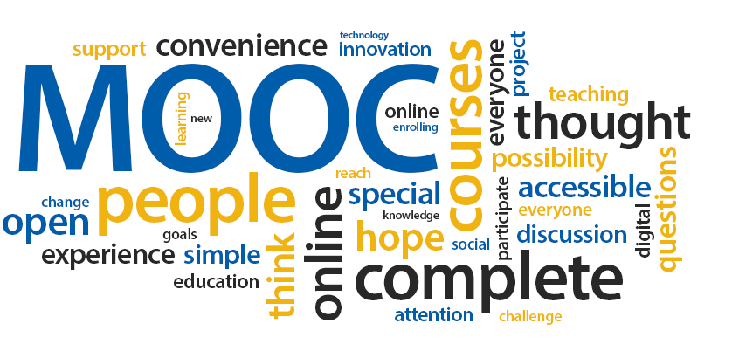
Scale - Open schooling MOOC

Slide 15
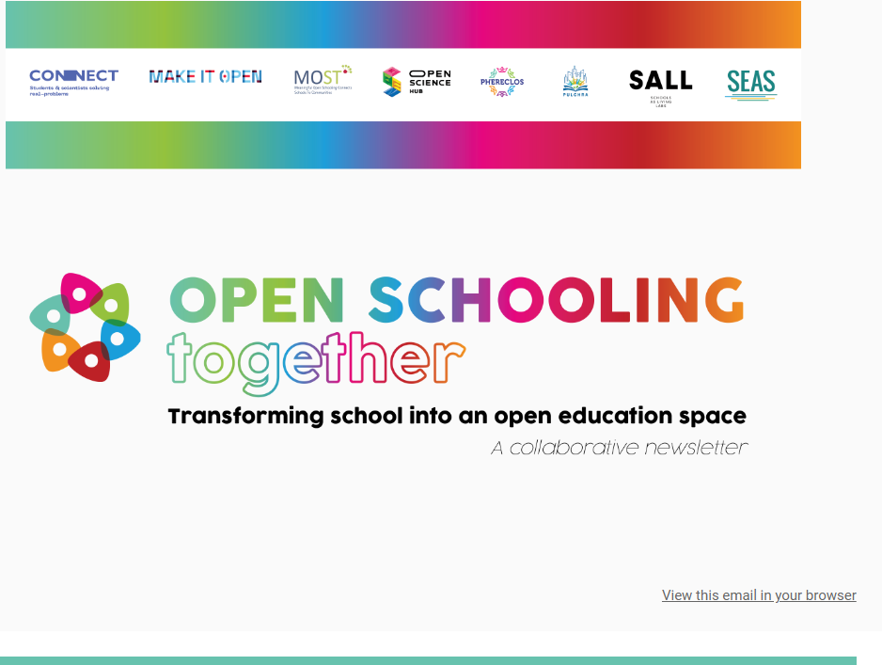
Collaborate

Slide 16
Questions?

