Slide 1
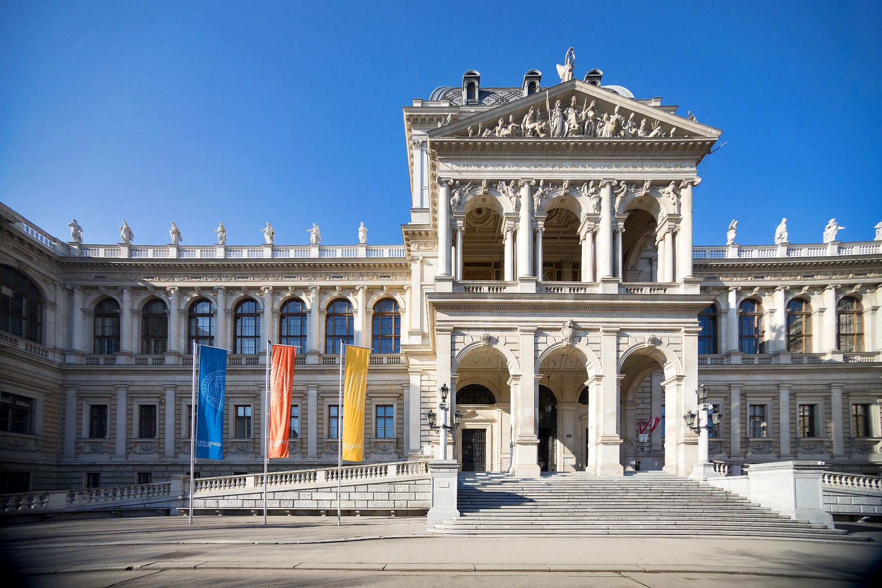
FIRST GENERATION
Ready for university!
PHERECLOS „Lay of the Land“ Conference Bucharest
08.09.2022
Eva Resch
Thomas Troy

Slide 2
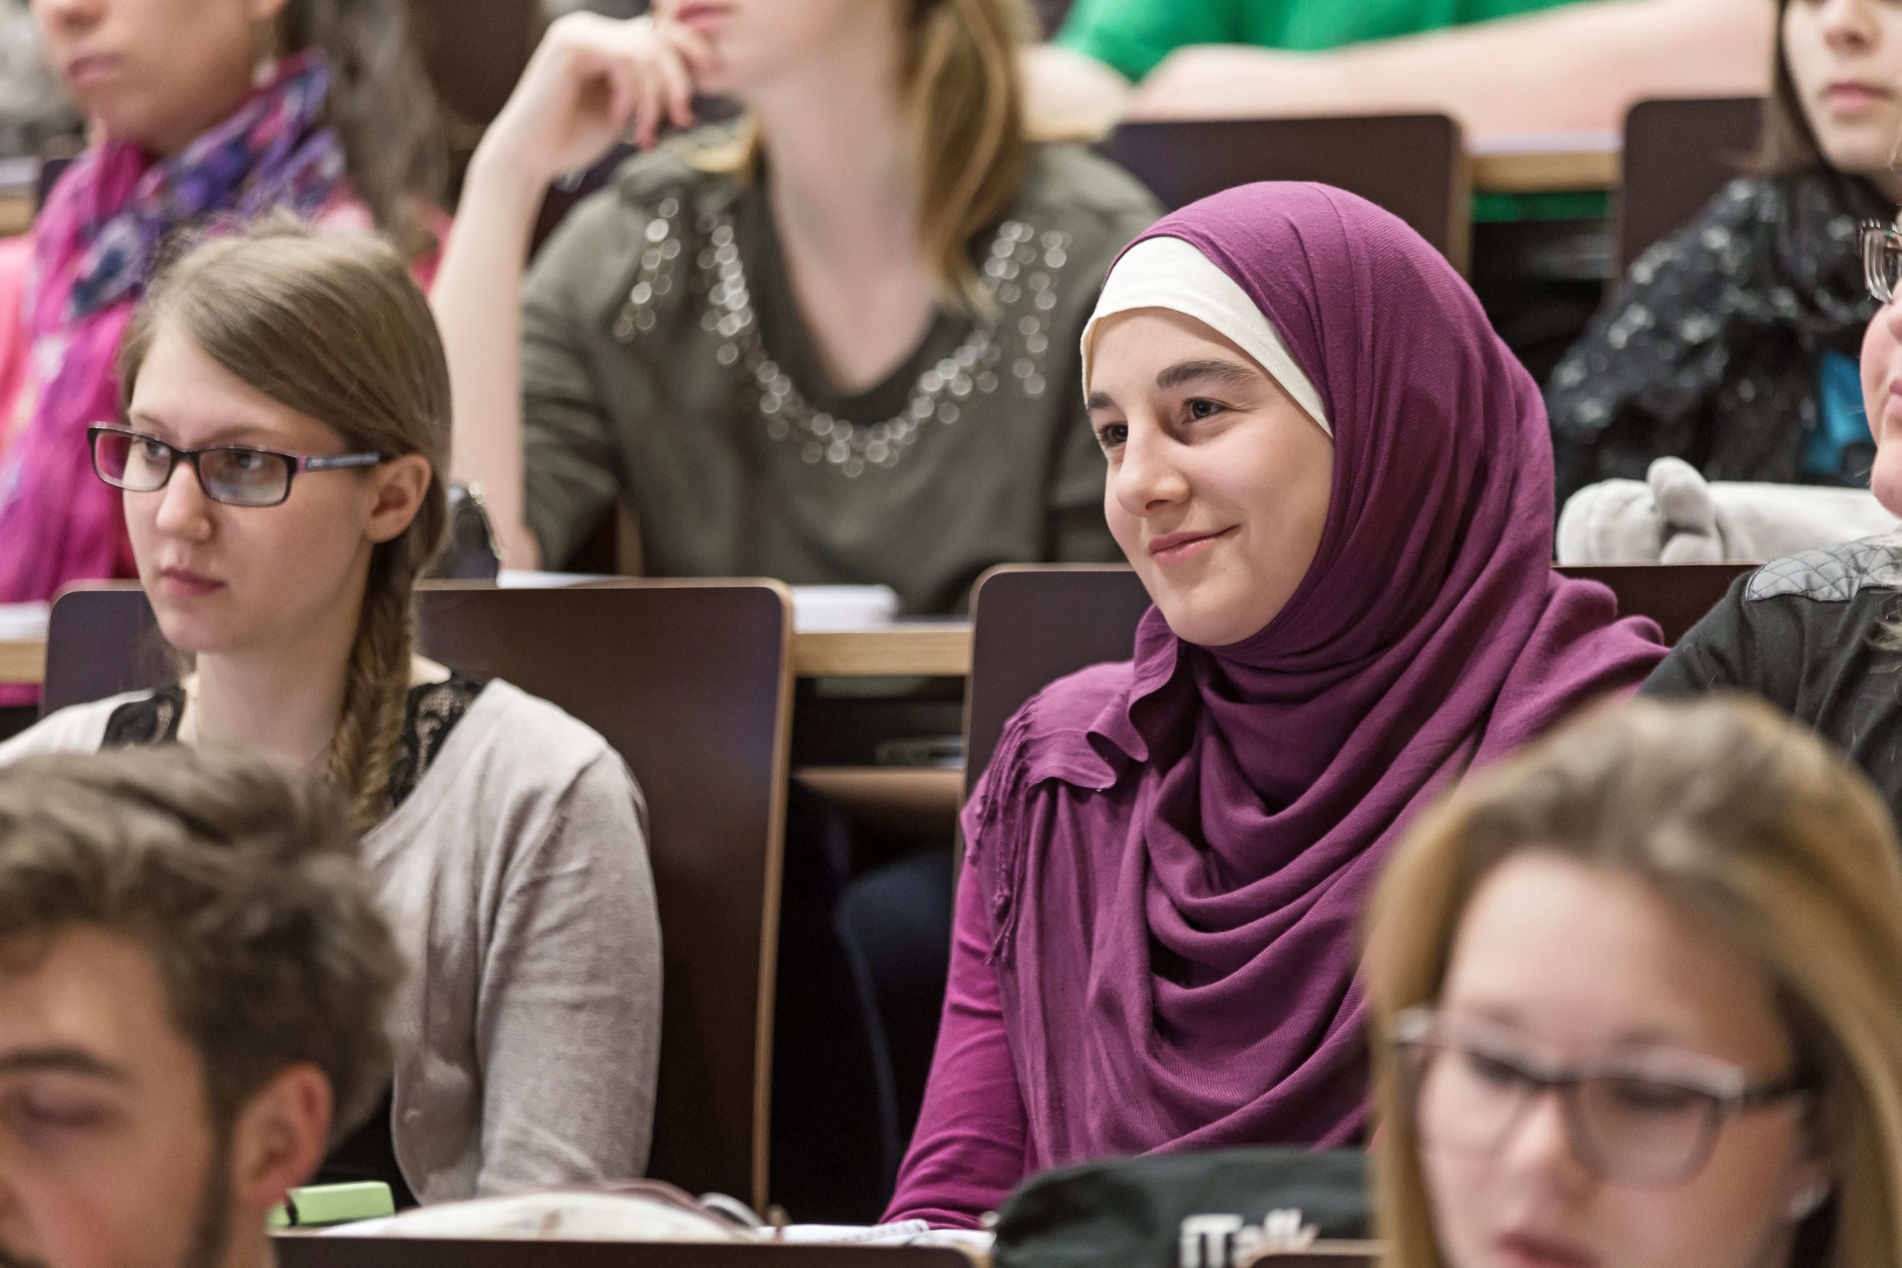

Overview
First Generation Project
Interactive World Cafe-Session
Learnings
Outlook
Wrap-up

Slide 3


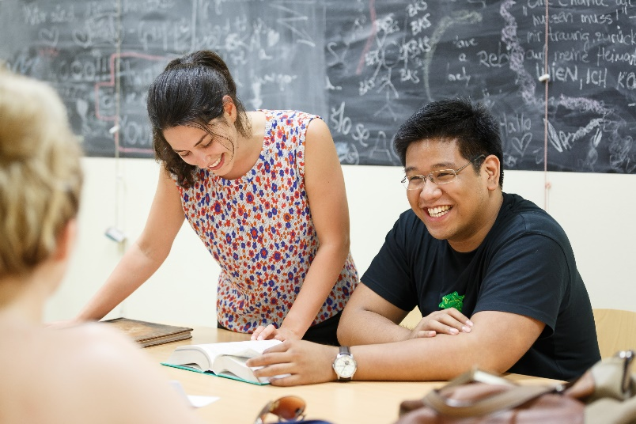
First Generation Idea
Pilot project for 15 school students from „Gymnasium am Augarten“
Study at the university - gain first experiences
Discuss all their questions and challenges

Slide 4






What? When? Where?
Miscellaneous
NOVEMBER
5 Workshops (a 3 hours)
Set dates with school students (2 dates/workshop)
Where: University of Vienna and DOCK
Concretise
OKTOBER
Information
SEPTEMBER
Children‘s University
Orientation
July
Acquaintance
June

Slide 5
Initial conception
Date | Topic | Aiming at:
June | Acquaintance | Compile questions and expectations: What are you expecting from the workshops? How do you consider studying?
July | Orientation | Daily life of students, Guiding tour through the university, correlation between pre-scientific work and university
September | Information | Idea of studying field, finding relevant information, develop a plan
October | Concretise | Registration period, Admission exam? Expectation vs. Reality
November | Miscellaneous | Scholarship, part time job, insurance, housing

Slide 6
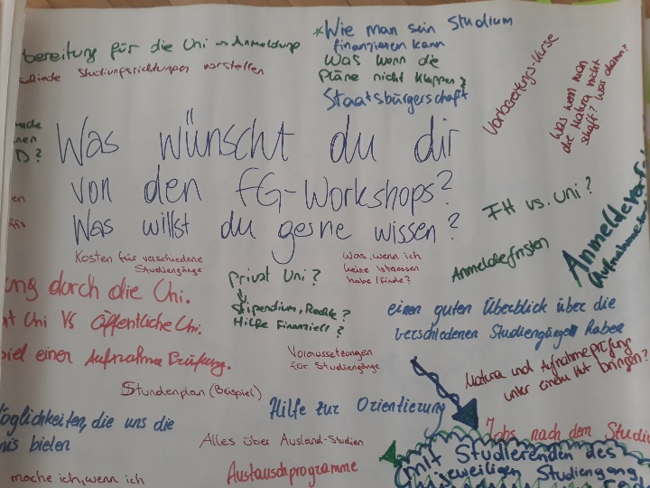
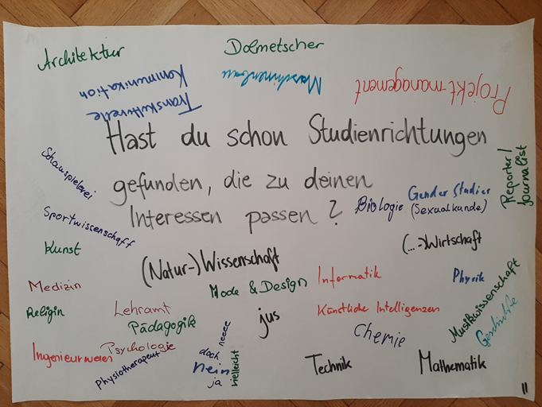
Implementation of the project
From 15 to 35 school students
1. Workshop: 25. and 28.6.2021
Input: World Cafe for orientation
2. Workshop: 19. and 20.7.2021
Input: Difference between University and University
of Applied Sciences with students

Slide 7
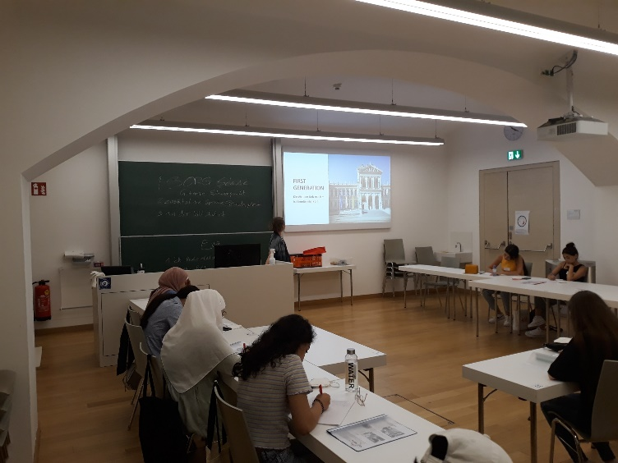
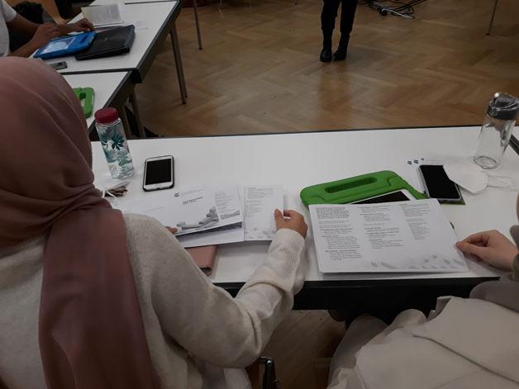
Implementation
3. Workshop: 15. and 21.10.2021
Input: Psychological Counselling Center
4. Workshop: 05. and 11.11.2021
Input: Austrian National Union of Students
5. Workshop: 03. and 04.02.2022
Input: Students from various universities give insights

Slide 8
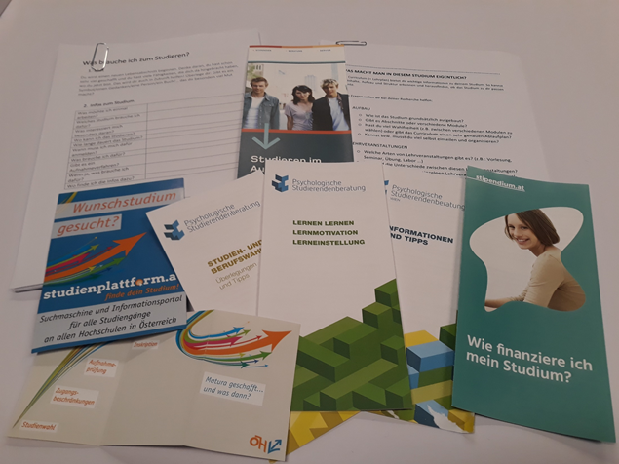
Communication
Padlet for questions/interesting links:
https://padlet.com/thomastroy/firstgeneration
Map to collect handouts und info material
WhatsApp group for low-threshold communication

Slide 9
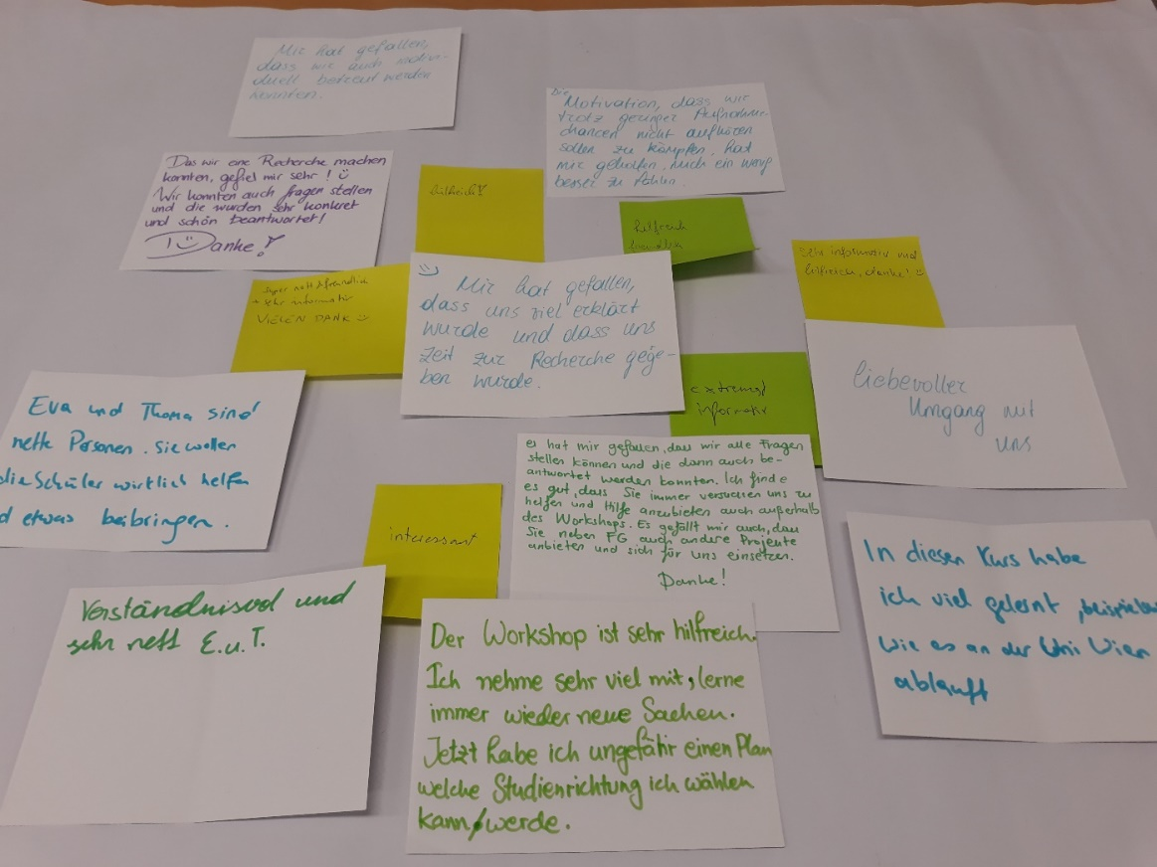

Feedback First Generation Students
"The workshop is very helpful. I take a lot of information from the workshop. I learn new aspects all the time. Now I have an idea which study programme I can or will choose.”
„In these workshops I learned a lot, for example how the University of Vienna operates.“
„I appreciated that we were able to ask all the questions. I like that you constantly try to help us and offer help – even beyond the workshops.“

Slide 10
Feeback to schools/university
“I'm certainly far too unprepared (from school) for university. Do I want to study at all? I am a little afraid of growing up”
Knowledge of the university programme depends on
individual teachers
Website University of Vienna: which information is really relevant
Professional occupations too vague: need for precise job titles and salary information
Schools cover diverse educational pathways insufficiently
Expand the mentoring programme
  Linguistic barriers (scientific language)
In the course of the studies: Support/Learning assistance

Slide 11
Learnings
Padlet: mainly used by us – how do they get the relevant links?
Very diverse fields of study and knowledge
5 sessions lasting 3h too extensive
Cycle of the workshops is important
  Scheduling the November date was challenging
Guest speakers need to be prepared well in advance
Auditoriums at the university are sometimes intimidating
  Important to get to know the university
Most of them know their preferred field of study but need more information regarding the next steps necessary

Slide 12
Why First Generation Workshops?
Universities should offer more programmes for schools and interested pupils
Multi-hour workshop format useful
There is a need: consult, advise …
Identify and clarify misconceptions/negative perceptions
Indicate support programmes
„ The motivation that we should not stop fighting despite the low chances of
admission, helped me to feel slightly better”
56% of all interviewees stated that they get their information from friends and family or social media

Slide 13
Supporting school students
I feel overwhelmed and have no idea what I want to study nor how to come to a decision
They should welcome the new students as well as possible, as many will be very young and will therefore need a lot of assistance
worry, fear, insecurity, excitement, getting independent, difficult, stressful, responsibility
I have great respect [regarding the transition] because I do not know how it will be. These thoughts intimidate me, to be honest
I cannot wait to enroll at the university, be independent and pursue my interests

Slide 14
Outlook First Generation
University of Vienna: included the First Generation Programme in their performance agreement
  leading document of commitment between the Austrian Federal Ministry of Education, Science and Research and the University of Vienna, valid from 2022-2024
Project will expand and sustainably embedded
  2022: aiming 200 school students
  2023: aiming up to 400 school students
Adapted structure:
  3 Workshops á 3 hours
  Focus on the University of Vienna
  2 ways of reaching the target group: workshops and school events for low- threshold communication
80% of all interviewees stated interest in joining the First Generation Project

Slide 15
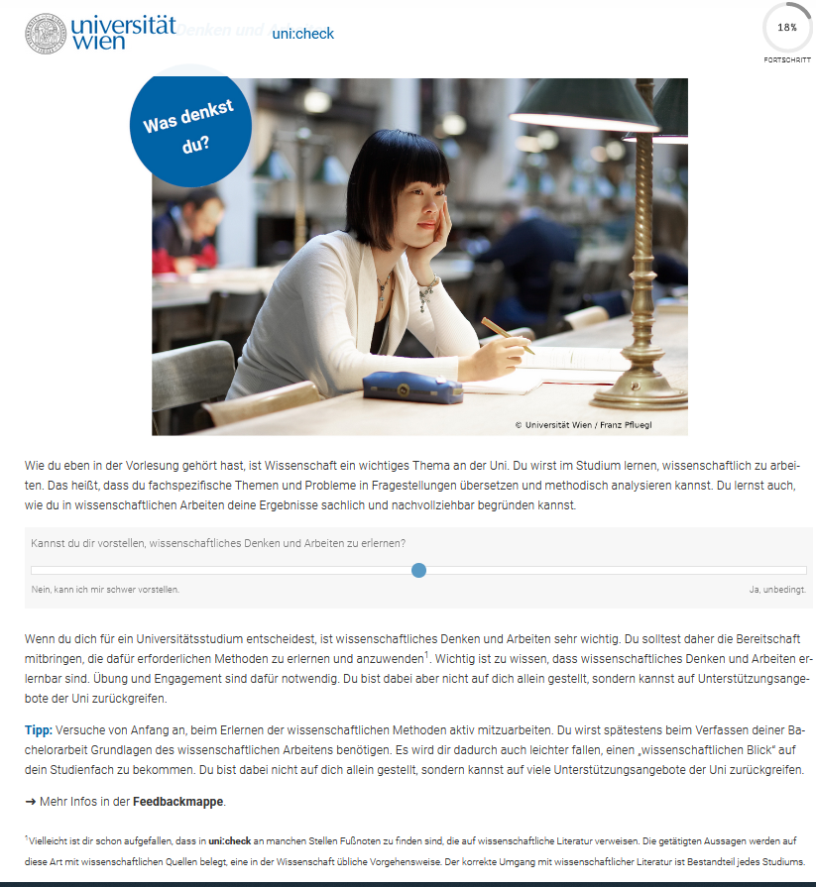
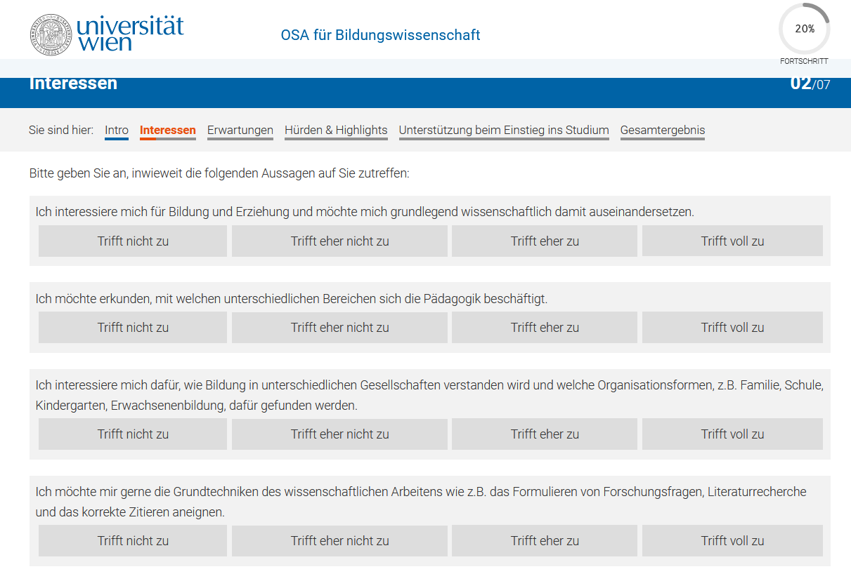
Support University of Vienna
Uni:check:
Gaining an overview about studying at the University of Vienna
Receive feedback
Duration: approx. 45 Minutes
Online Self Assessment:
Students learn about the emphasis of the study field and align it with their interests and strength
Voluntarily but for some studies prerequisite
Duration: 30-75 Minutes
No recommendation if you should study this subject

Slide 16



Further information
Interested in the programme:
www.first-generation.at
In Zusammenarbeit mit dem Bildungsgrätzl Wallenstein 2.0

Slide 17
Credits
Page 1: Universität Wien_Alex Schuppich
Page 3:Universität Wien_Barbara Mair (?)
Page 5, 6, 7, 8, 10: Vienna University Childrens Office

