Slide 1




Another brick leaves the wall
Open schooling for a new education
Claudia Aguirre Rios
TRACES Association
FRANCE

Slide 2
3 statements…

Slide 3
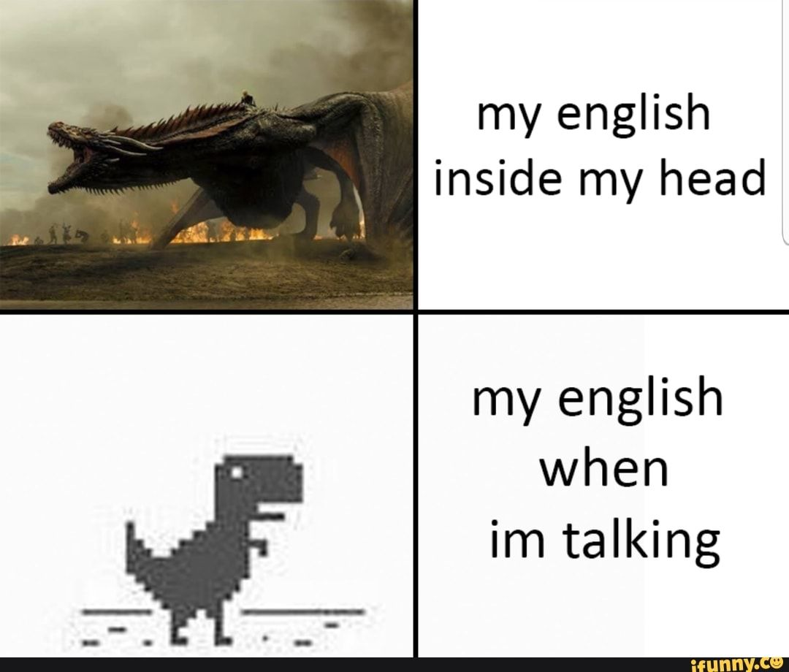

Slide 4
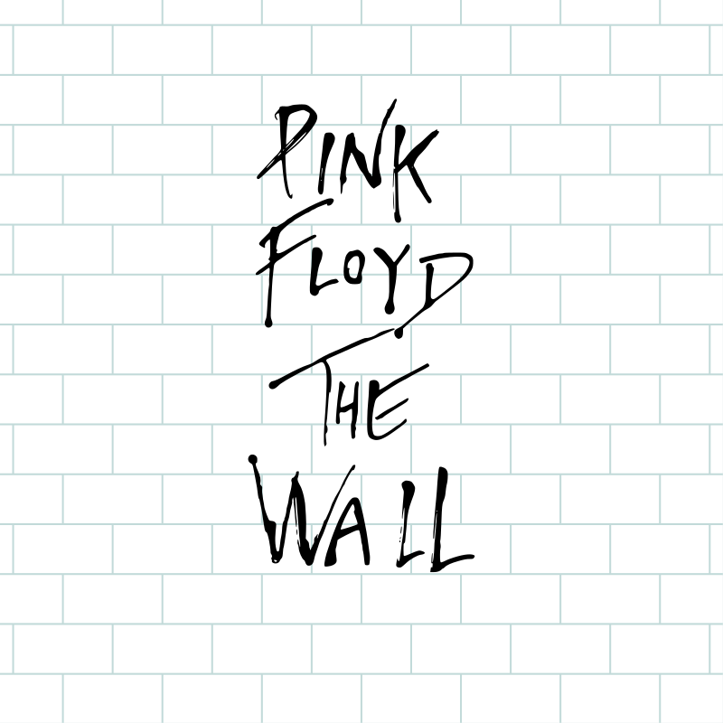

Slide 5
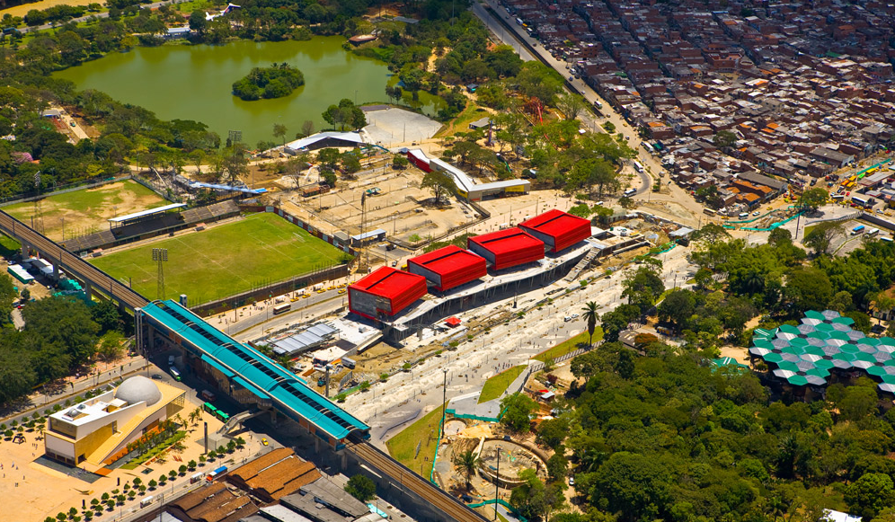

Slide 6

We don’t need no education!
(Yes, we do! Just a different one)

Slide 7
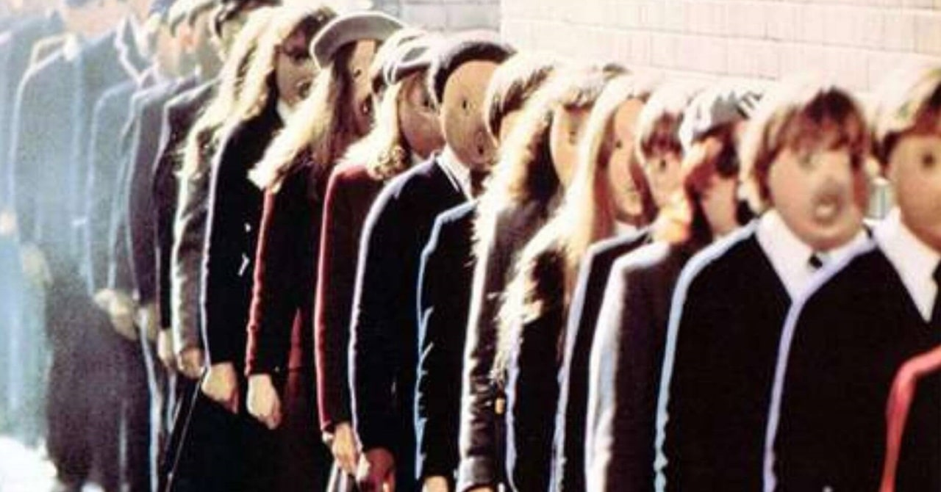

Slide 8
What kind of education?

Slide 9
Hey! Teacher! leave them kids alone
(no, not really)

Slide 10
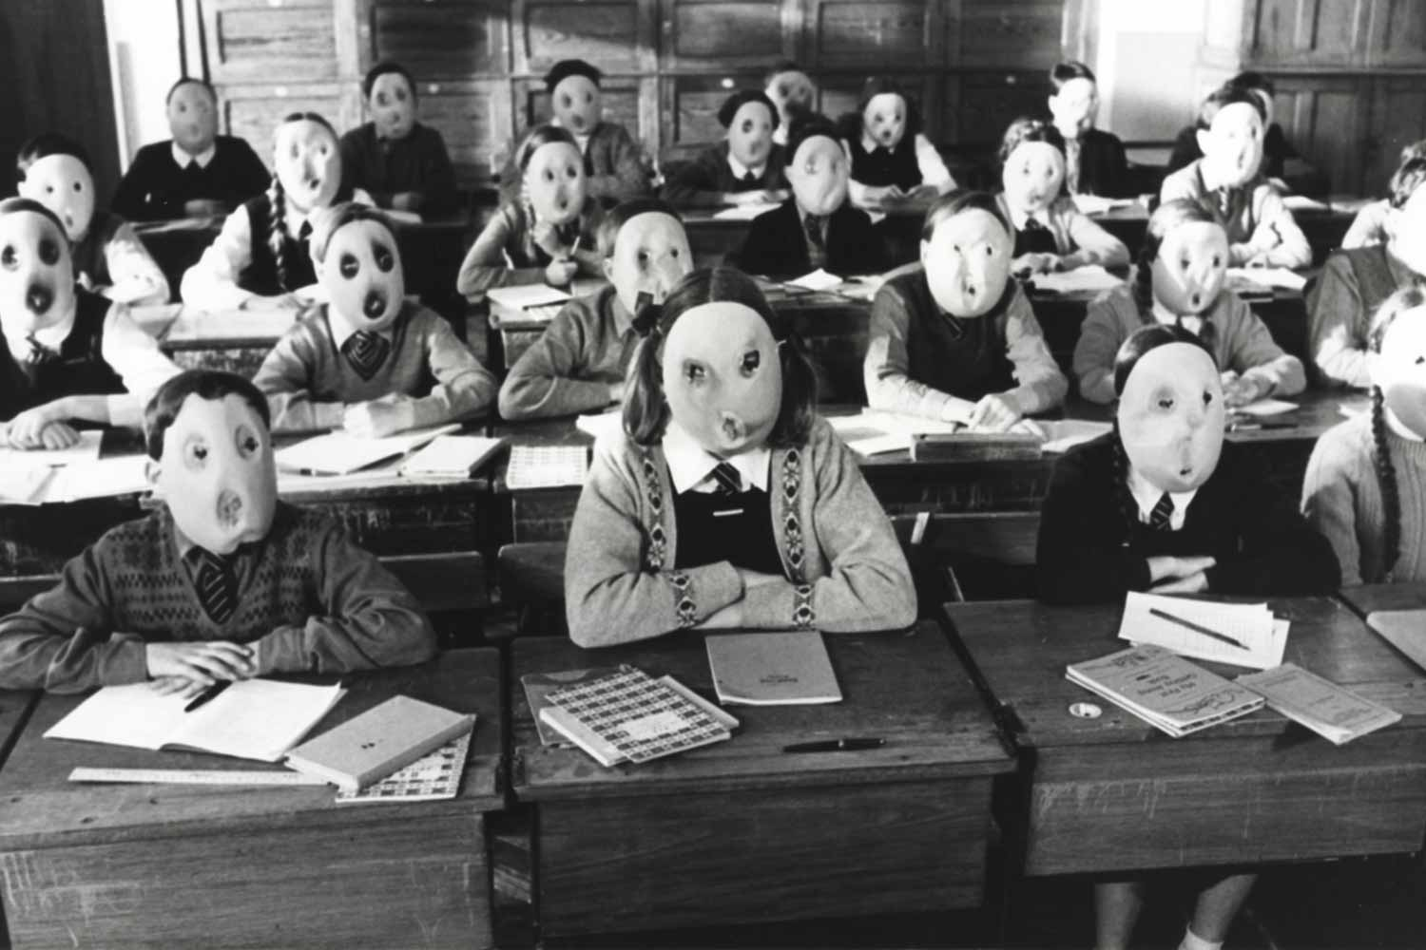
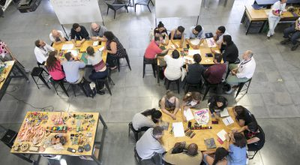
OPEN SCHOOLING
Closed, isolated full of contents rooms
Innovative ecosystems, shared sites of science learning

Slide 11
The benefits of Open Schooling on STE(A)M learning

Slide 12
Key messages
Open schooling can support STE(A)M learning better for the majority of students than traditional methods
Open schooling brings the benefit of active citizenship through community engagement into STE(A)M education
Policy Brief #1 - Phereclos

Slide 13
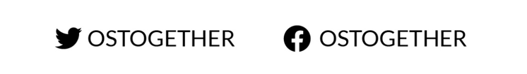
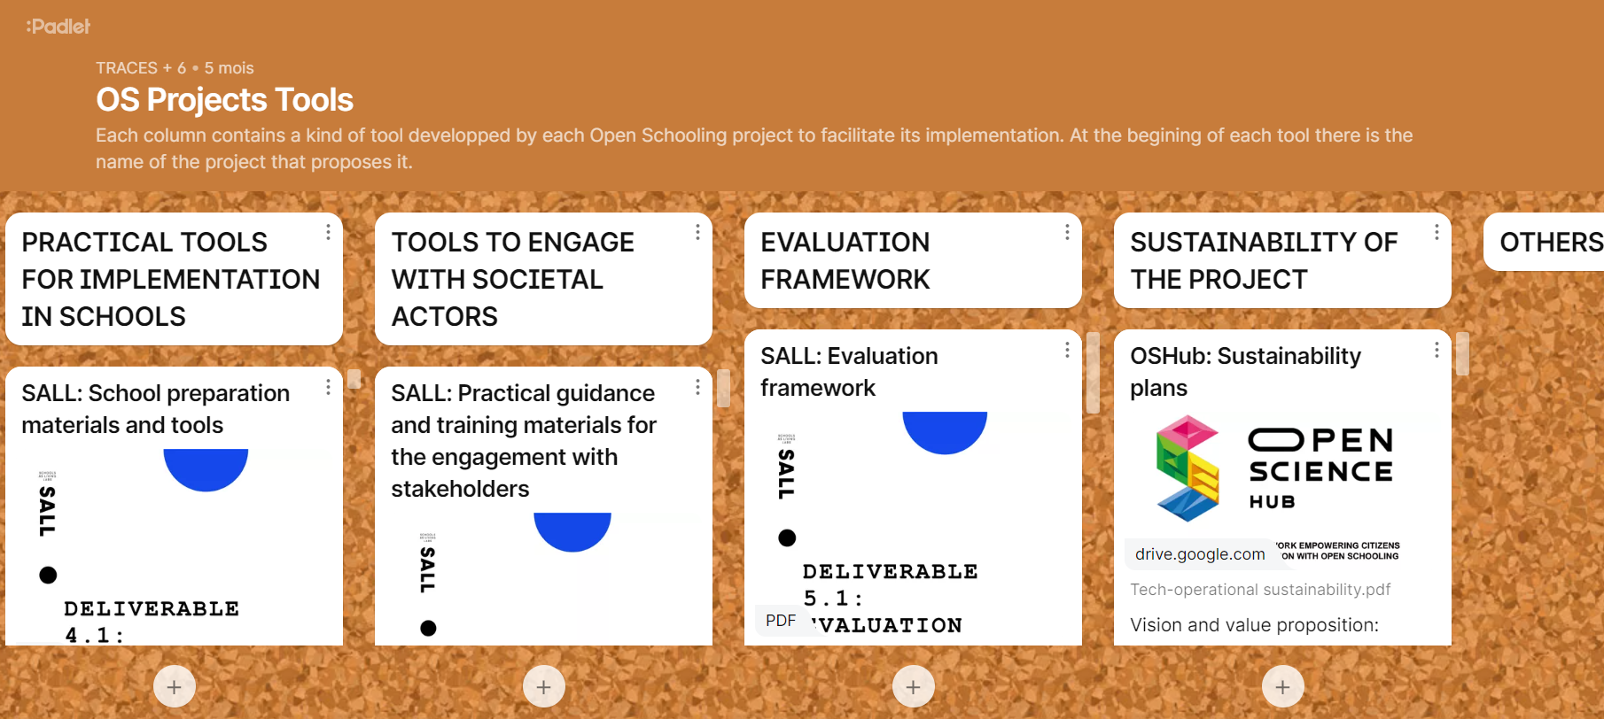
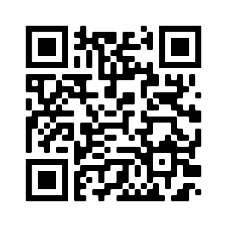
OS together

Slide 14
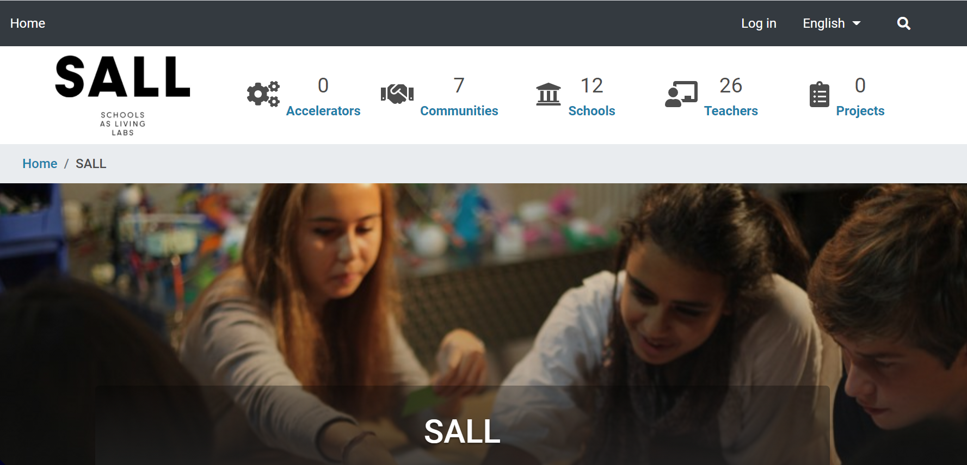
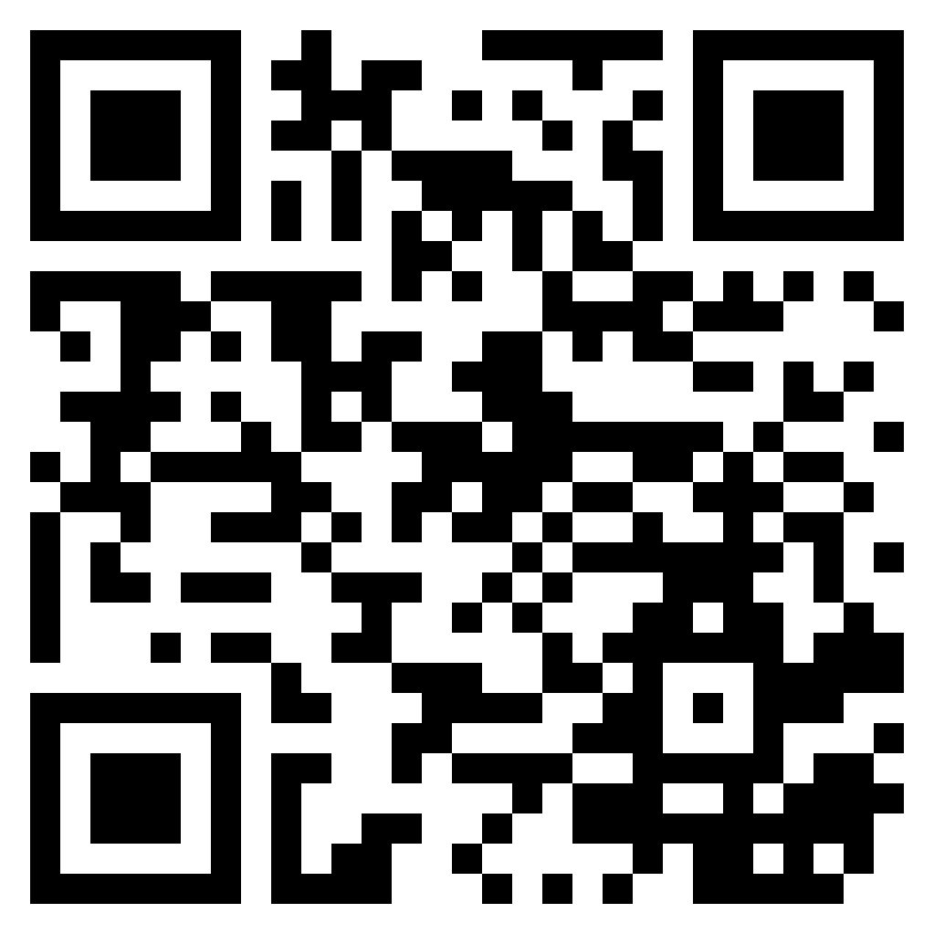
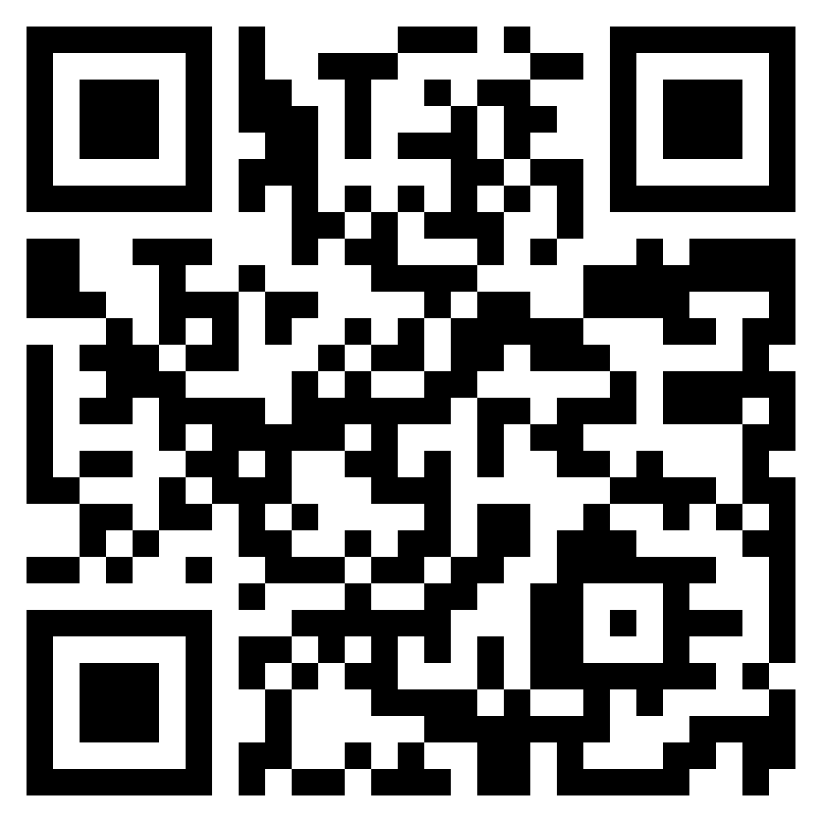
SALL – SCHOOLS AS LIVING LABS
Community Platform
web site

Slide 15
What if the problem is somewhere else (not at school)?
Community Platform
web site

Slide 16
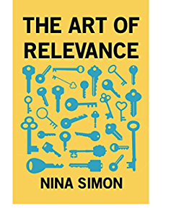
“Relevance is about making connexions that unlock meaning and value”.
“It opens doors that matter to us, surprise us, and bring value into our lives.”

Slide 17
Friends words ABOUT OPEN SCHOOLing
“vital contribution to the community”
“student projects meet real needs of people they know”
“meaning and motivation”
“Lots of advantages: not just “share”, they really have to collaborate. It goes 2 ways: School with the society, for the society.”
“Myself as an education person, from education perspective, I find that it’s more relevant for students, because they work for them.”
“Self-motivated: internal motivation, not external. Which is VERY IMPORTANT in education.”
“They have an impact in people they know! They are leaving something for them.”
“In my opinion the open schooling is a different (and better) way to learn because the students get connected to real life issues, related with their own experiences and their daily routines. Through open schooling, students can apply and experience what they (may have) learned in text books to the "real world".

Slide 18
All in all, you're just another brick in the wall
(Yes, all in all, they are! And a great kind of brick!)

Slide 19
OS exemples
This community dared to give its young students a place... and today they all work together for the recovery of the town.
Photo : Radio Canada
Sainte Marie – Québec (Canada)
Photo : Beauce Média - Hubert Lapointe

Slide 20
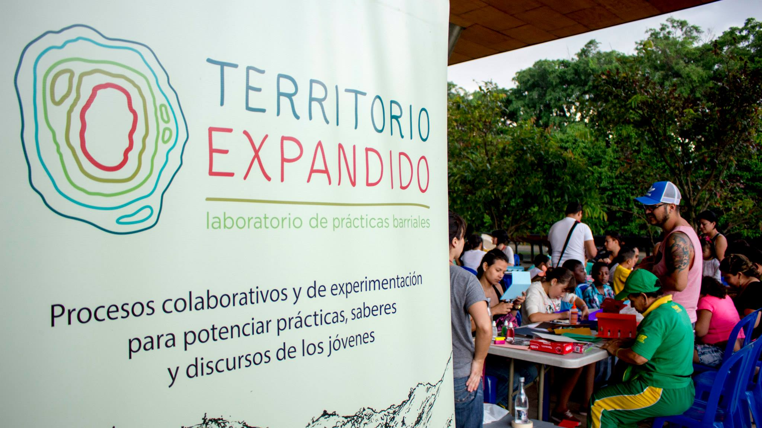
Photo : Parque Explora

Slide 21
We don't need no thought control
(We want to decide and to participate!)

Slide 22
For a country within the reach of children
Gabriel Garcia Marquez (1994)
"...our conformist and repressive education seems designed so that children adapt by force to a country that was not intended for them, instead of putting the country within their reach so that they can transform and enlarge it.
Such nonsense (…) contradicts the imagination (…) and the wisdom of the heart, until children forget what they undoubtedly know from birth: that reality does not end where the texts say, that their conception of the world is more in accordance with nature than that of adults, and that life would be longer and happier if everyone could work on what they like, and only on that."

Slide 23


www.schoolsaslivinglabs.eu
claudia.aguirre@groupe-traces.fr
www.groupe-traces.fr

