Slide 1
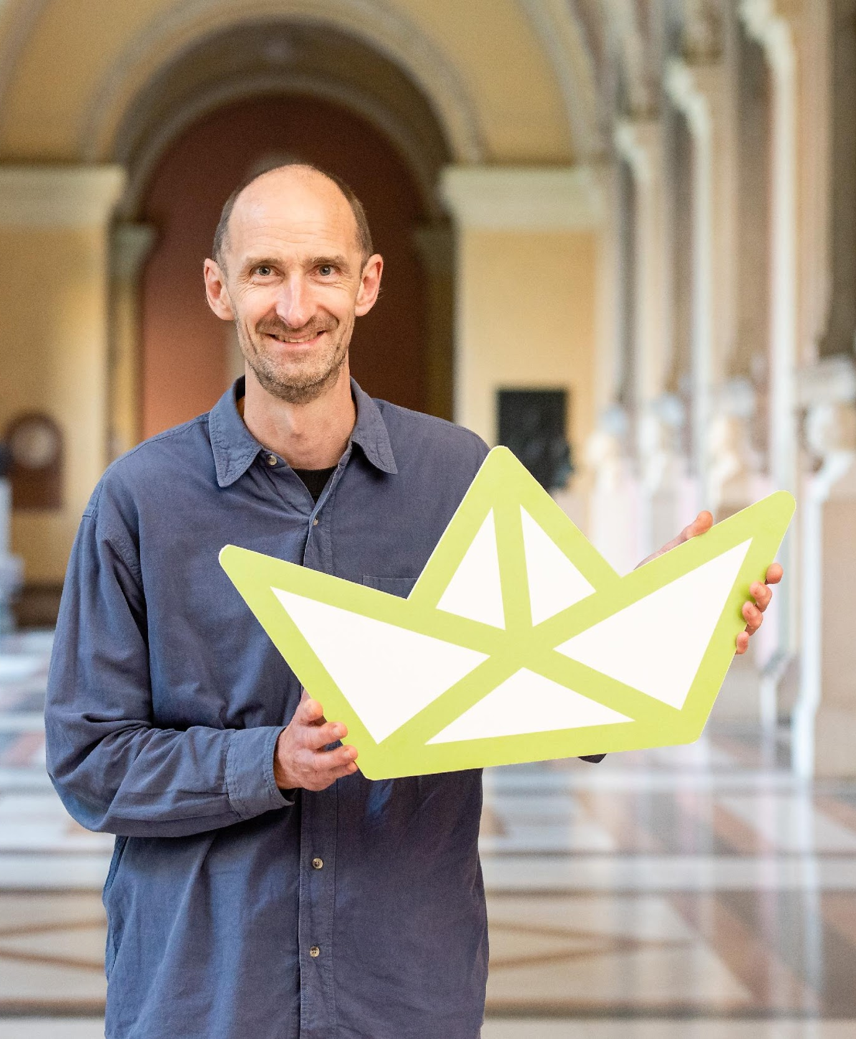
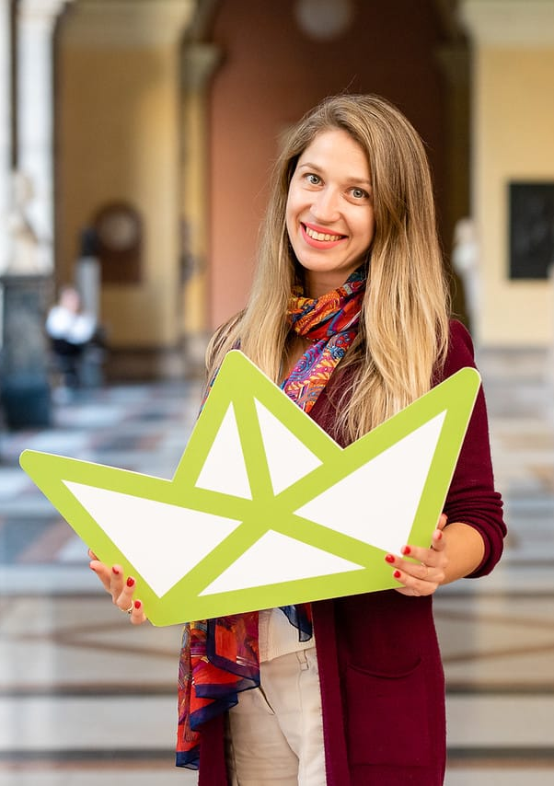
Inspirations and initiatives in micro-
education ecosystems : PHERECLOS Open
Schooling Approach
Laura Cristea^{1,}, Phil Smith², Silvia Prok ³, Chris Gary⁴, Cyril Dworsky⁵, Florian Huber⁶,
Children’s University Association, Romania¹, Teacher Scientist Network, UK ², Universität Innsbruck, Austria ³ , Kinderbüro Universität Wien, Austria^{4,5}, SYNYO, Austria⁶
This project has received funding from the European Union’s Horizon 2020 research and innovation programme under grant agreement No 824630.

Slide 2
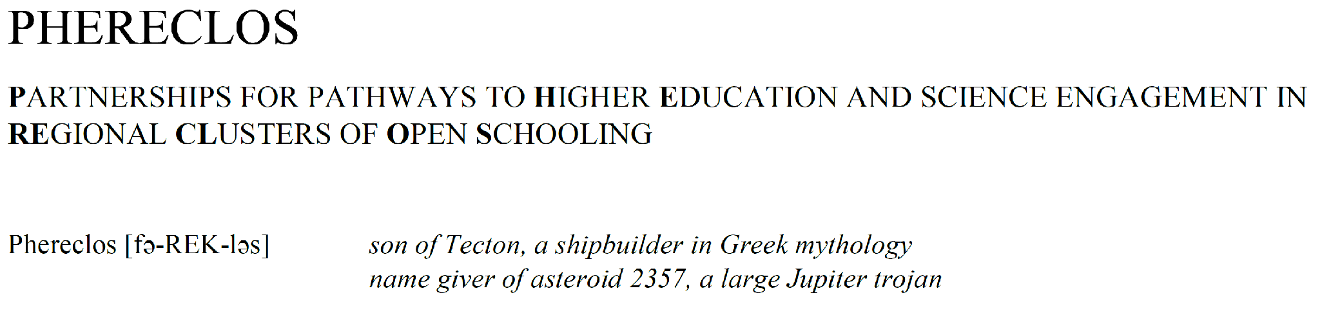
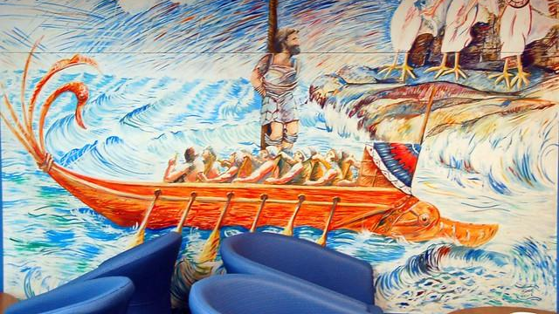

The project basics

Slide 3
The project basics
Funding: EU-funded initiative (Horizon 2020)
Science with and for society (SWAFS)
Topic: “Open schooling and collaboration on science education”
Coordinator Kinderbüro Universität Wien Gmbh
        (Vienna University Children’s Office, Austria)
Number of partners: 15
Number of partner countries: 10
Project start date: 1st Oct. 2019
Project duration: 36 months

Slide 4
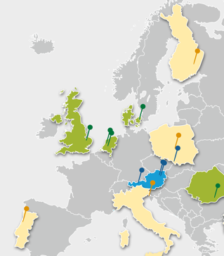

Project Partners
Vienna University Children’s Office – Austria – Coordination
SYNYO GmbH - Austria – Technical Background
Universität Innsbruck – Austria – Knowledge platform, good practise library
Uniwersytet Slaski – Poland – Transnational Mentoring Partnerships
Universität Wien – Austria – Implementation Studies
Universitatea Copiilor – Romania – Dissemination & Childrens Perspective
European School Heads Association - Netherlands - School Heads Perspective
International Parents Alliance – Netherlands – Parents Perspective
Teacher Scientist Network – United Kingdom – Teachers/Training Perspective
Kobenhavns Universitet – Denmark – Teachers/Training Perspective
Snellman-instituutti – Finland – LEC Kuopio
Politechnika Łódzka – Poland – LEC Łodz
Universidade do Porto – Portugal LEC Porto
S.I.S.S.A. Medialab - Italy – LEC Trieste
Universidad EAFIT – Colombia – LEC Medellin
Vienna University Children’s Office – Austria LEC Vienna

Slide 5
The overall aims
The overall aim of PHERECLOS is:
to develop models and recommendations for new ecosystems in education (LEC)
to support schools to become hubs of innovation and STEM engagement in a community
to build upon the experience of Children’s Universities as “incubators of change”
to meet - with their activities - the real needs in the community outside of schools

Slide 6
The overall aims
The overall aim of PHERECLOS is:
to draw on local expertise and experience from ALL different stakeholders of ALL sectors (cross-sectoral and cross-disciplinary cooperation)
to link science engagement with practical experience and real life
to support sustainable local frameworks for innovative collaboration in education (in and around schools)
in order to better respond to the “learning crisis”

Slide 7
Phereclos is based upon these 3 ideas
- The conceptual framework -
Science Capital
goes back to Pierre Bourdieu - underlines aspects of social inclusion
Children’s Universities
the proven idea of Children’s Universities as intermediaries between various parties in the Third Mission of universities - and incubators for the opening of universities towards the public and for promoting educational opportunities
“The concept of science capital is a way of encapsulating all the science-related knowledge, attitudes, experiences and social contacts that an individual may have. [It] helps to understand that science is important for improving life chances, equity and success of all young people.” (Archer, L. et.al. 2015)
Science Capital
Children’s Universities
Open Schooling
Open Schooling
the understanding of an Open School culture as a model of how schools can better reflect on societal ideas, topics and challenges through external cooperation and a way to show the key role of schools in our society

Slide 8
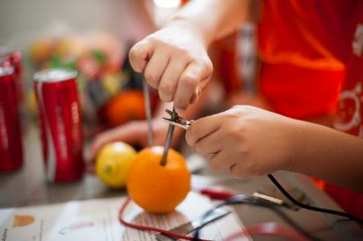

Children’s Universities
Encouraging children to be curious and to think critically - the mainsprings of research and science. Communicating to them (children) the idea of universities and providing insights into academic culture as well as their role in society at large (Third Mission)
Engagement with local and regional government, external actors – local communities / local impact
https://eucu.net

Slide 9
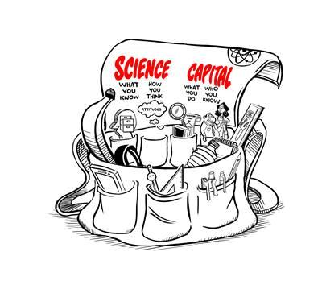
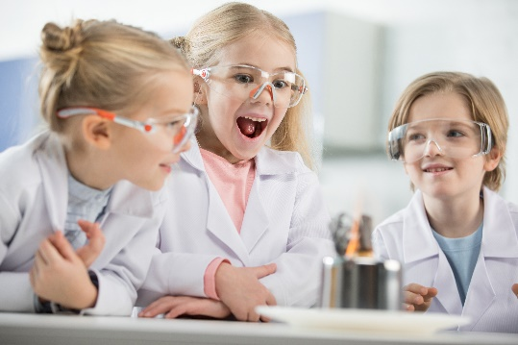
Science Capital
Refers to science-related qualifications, understanding, knowledge (about science and ‘how it works’), interest and social contacts eg .knowing someone who works in a science-related job, ASPIRES 2013
Can be thought of like a giant ‘holdall’ containing pupils’ knowledge, attitudes, skills and experience, which they carry around with them and use to negotiate life and to make decisions (inc. about their own career)

Slide 10
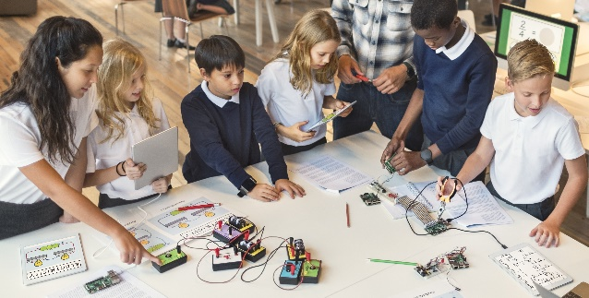
STEAM Engagement
STEAM: Science, Technology, Engineering, Arts, Maths
Future workforces require this skillset, yet their uptake and interest among young people, is declining.
Holistic education allowing pupils to develop both sides of their brain and engage with problem solving, fearlessness and critical thinking. Can involve external partners to contextualise curriculum

Slide 11
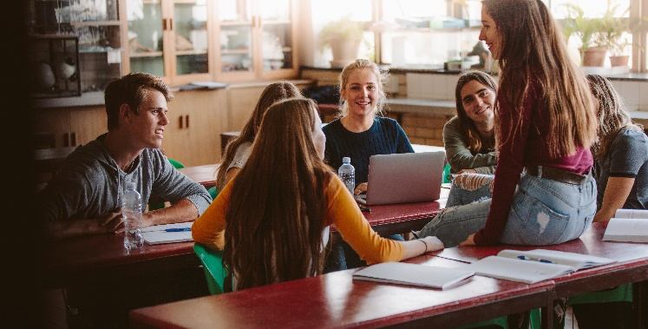
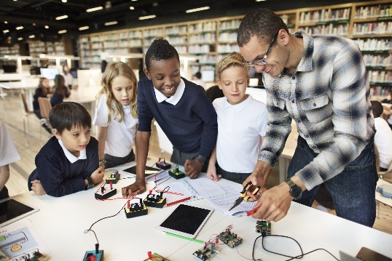
Open Schooling
Is where schools, in cooperation with other stakeholders, become an agent of community well-being, families are encouraged to become real partners in school life and activities , professionals from enterprise, civil and wider society are actively involved in bringing real-life projects into the classroom (EU Commission 2015, Science Education for Responsible Citizenship) – https://openscienceschooling.eu
operating a school in a way that reflects external ideas, topics and challenges and incorporates them in their teaching approaches and everyday school life, and in return, provides the creativity and potential as the assets of their pupils and teachers to the community around them.

Slide 12
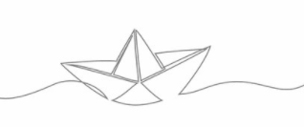
RESULTS
INITIATIVES
INSPIRATIONS

Slide 13
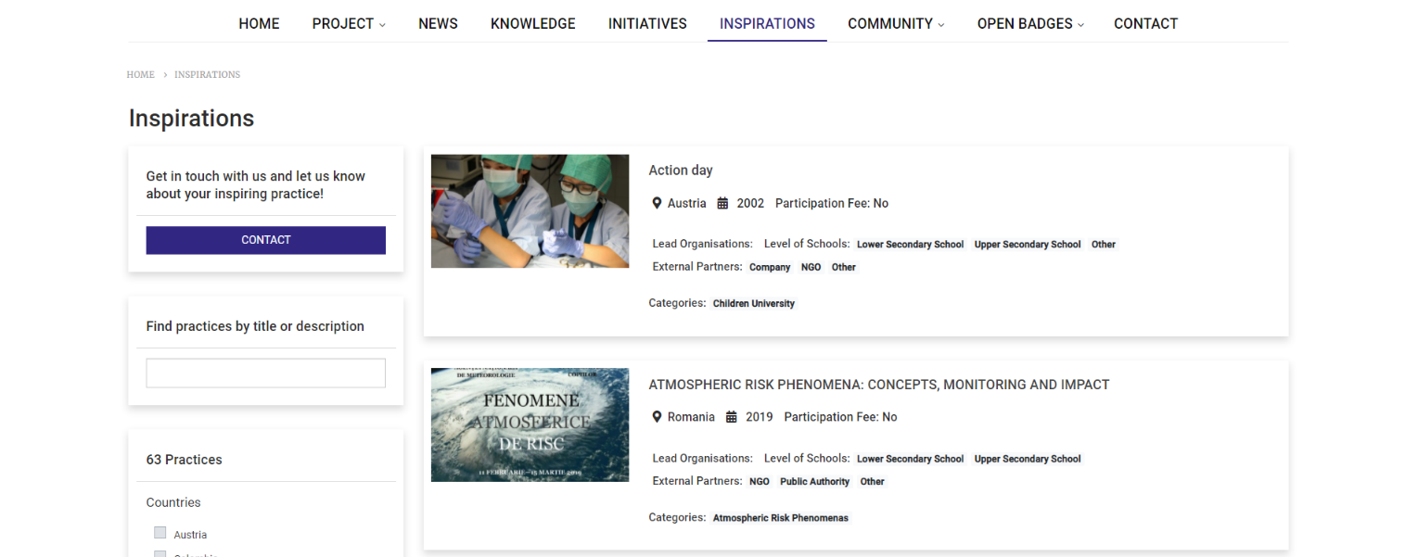
Inspiring Cases
63 examples of inspiring cases or practices have been gathered and catalogued.
Exemplars which can be used to inform and inspire our own programmes – LECs and TEMPS - & anyone else!
Searchable
https://www.phereclos.eu/practices
Varied in terms of scale, definition, target age-group

Slide 14
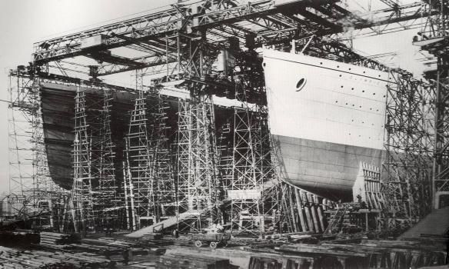
Policy Briefs
From the advocacy perspective consideration was given to the specific needs of a diverse number of stakeholders including teachers, school heads, teacher training students, parents and pupils..
The Benefits of Open Schooling on STEAM learning
School Autonomy and Stakeholder Engagement in Open Schooling
School Leaders and Teachers in Open Schooling
Non-formal Education Providers in Open Schooling
Financial Aspects of Open Schooling
Physical and Legal Barriers to Student Participation in OS
OS Lessons Learnt from COVID-19

Slide 15
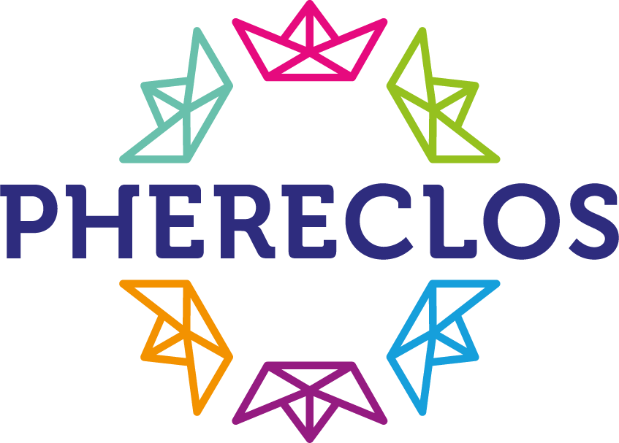
LOCAL EDUCATIONAL CLUSTERS
Rural area
#digital literacy #virtual science club
Capital city
#equal opportunities #inclusion
#network policy level
Kuopio Finland
Vienna Austria
Industry city
#job market #children conference
Łódź Poland
Medellin Colombia
Post conﬂict area #citizenship education #co-creation
#co-design
City of knowledge #barrier free system #gender equality #social inclusion
Trieste Italy
Porto Portugal
Trading city #entrepreneurship #family
#teacher training

Slide 16
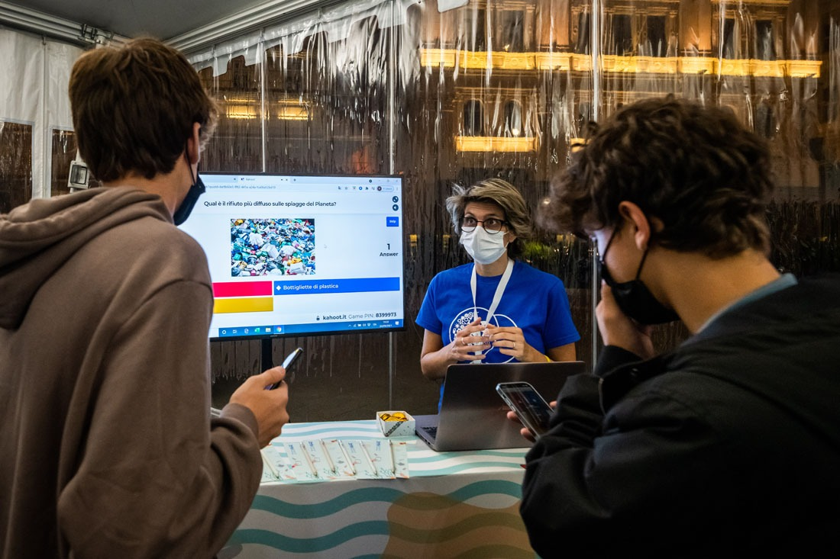
#LEC
Trieste
Italy
#LEC
Trieste
Italy
Activities for teachers & pupils with research community
A citizen science project realized within the Trieste LEC as a prototype of what we could do together http://zoomare.it
The zoomare project concerns the study of waste carried by the sea on the Trieste coast. Everybody can lend a hand to research: just take the photo in 9 points of the Trieste coast and share it with the community.

Slide 17
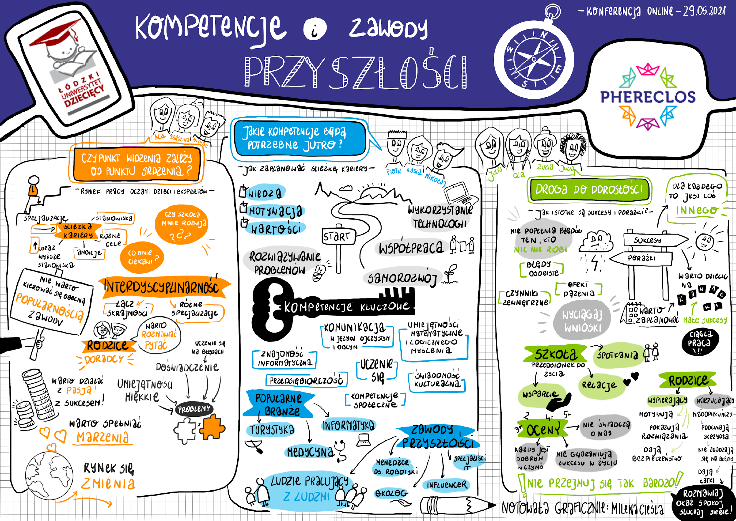
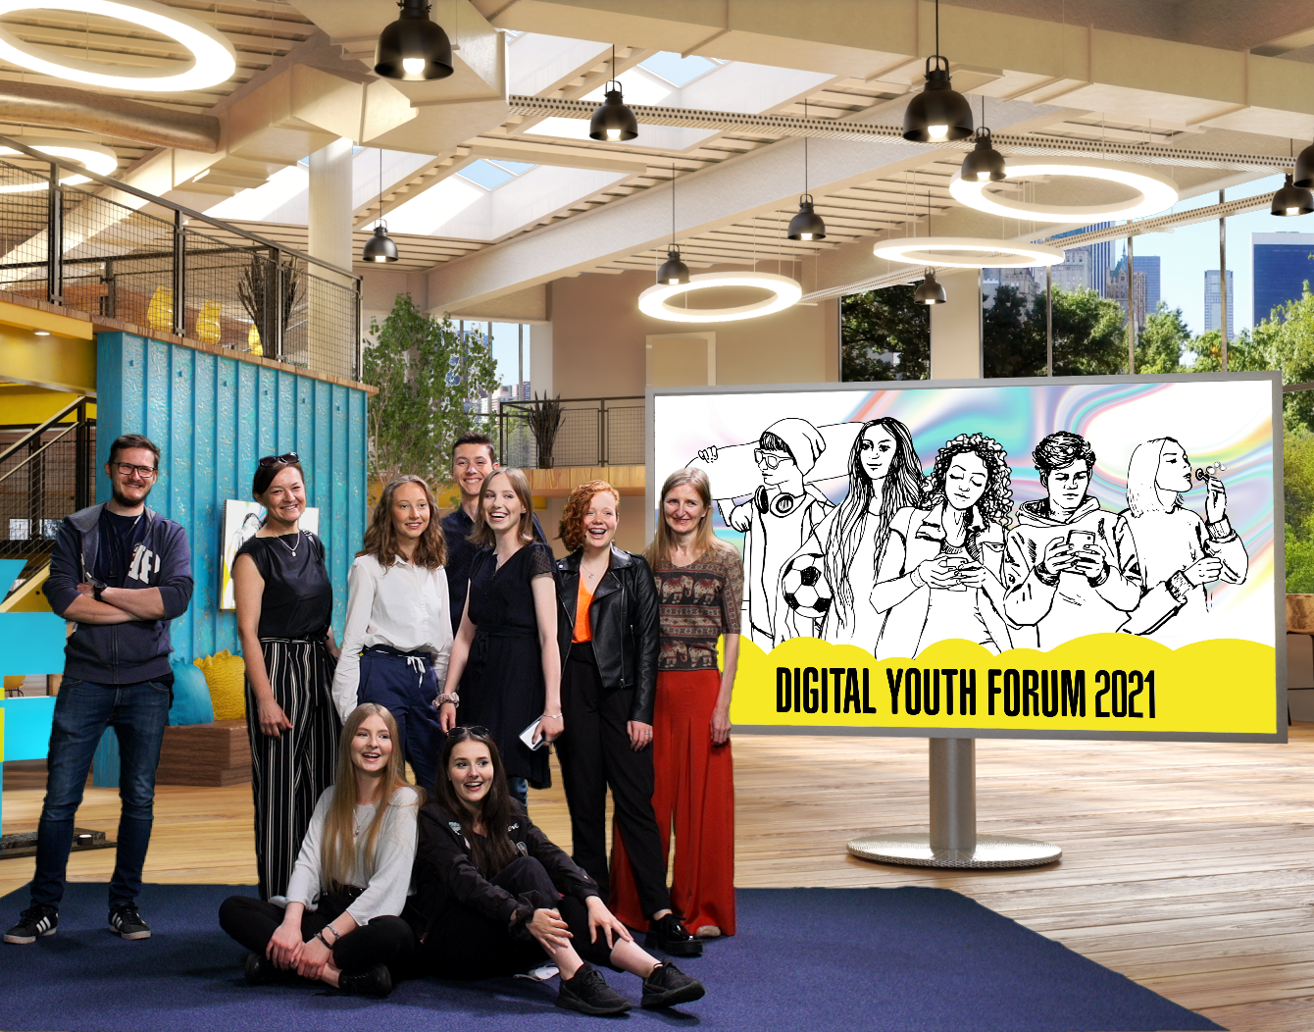
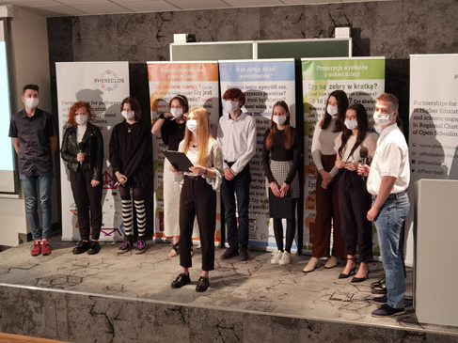
#LEC
Łódź Poland
#LEC
Trieste
Italy
Labour market conferences – by students for students
1
1000 collected and analyzed questionnaires
1 online conference / 1 face-to-face (primary school)
100 workshop participants
560 views of the conference on Youtube
7 interviews in various media after the conference
10 June 2021 – Digital Youth Forum!
41 Instagram posts
7 interviews with entrepreneurs conducted by children

Slide 18
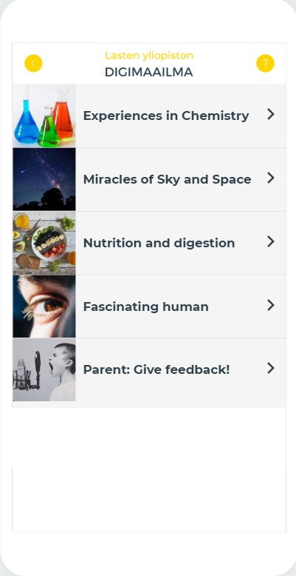
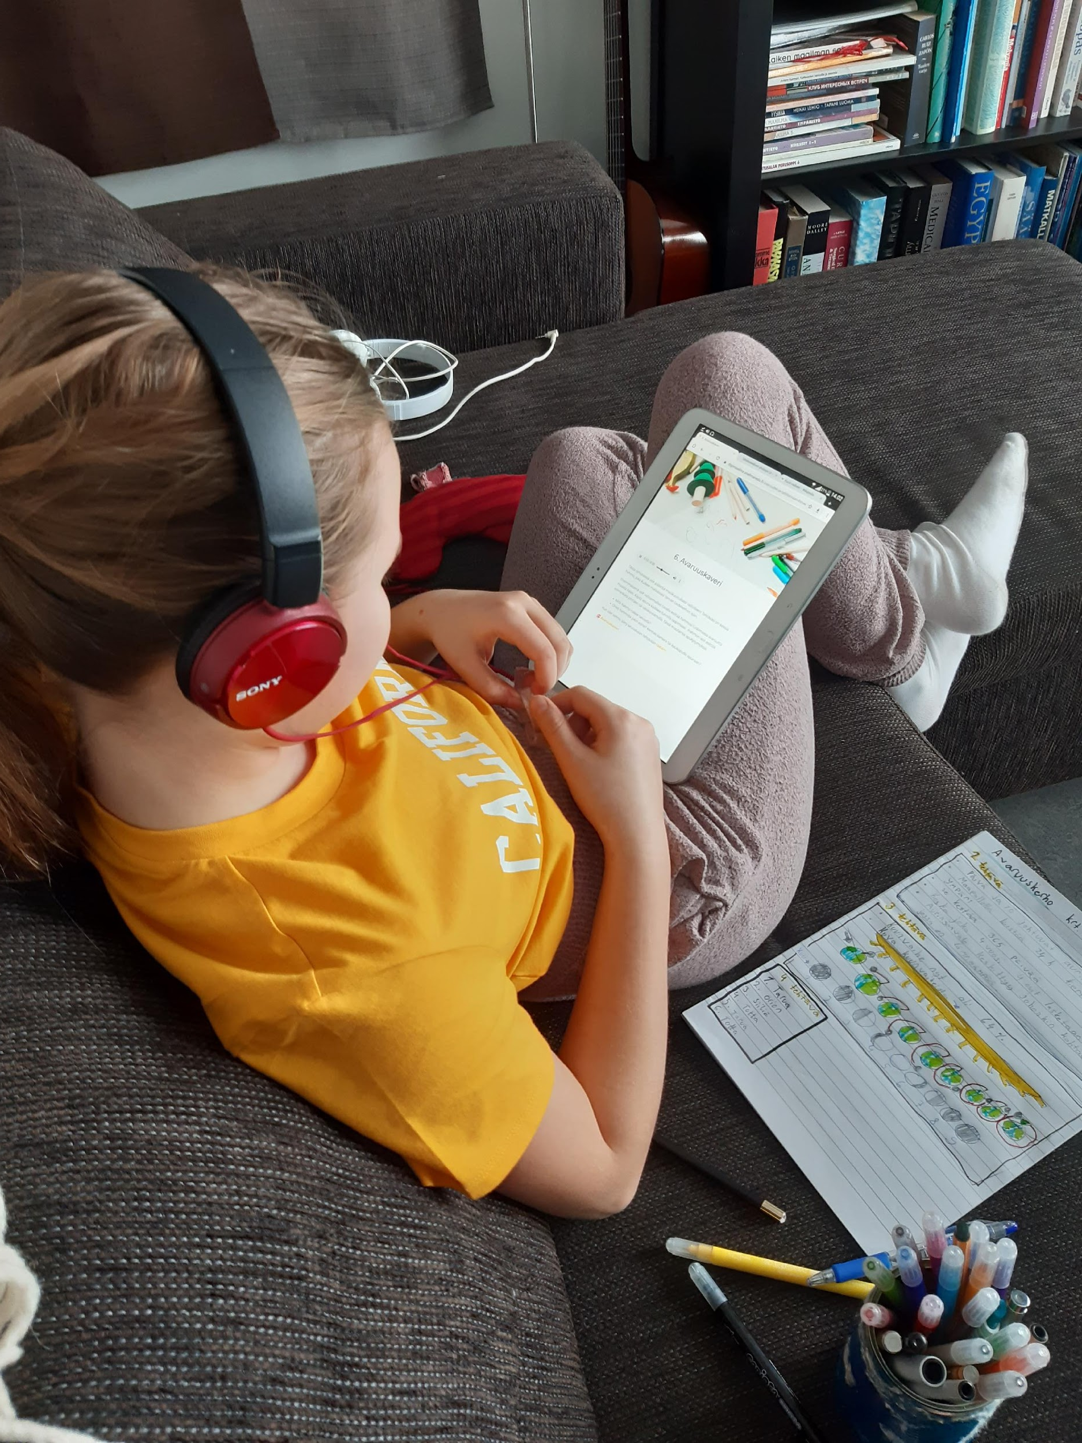
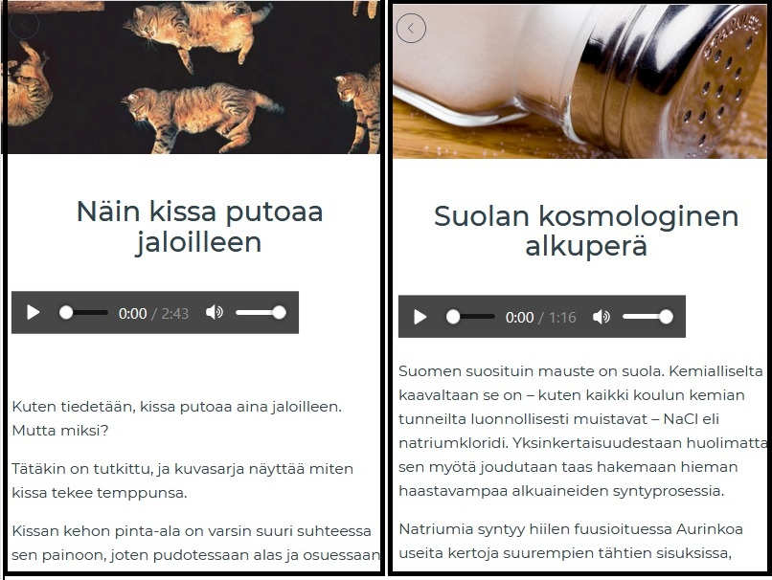
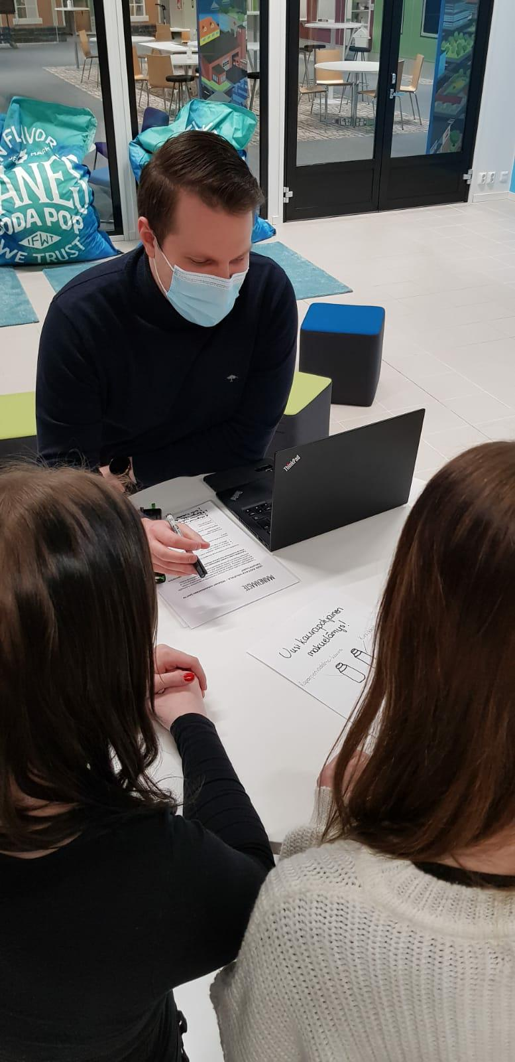
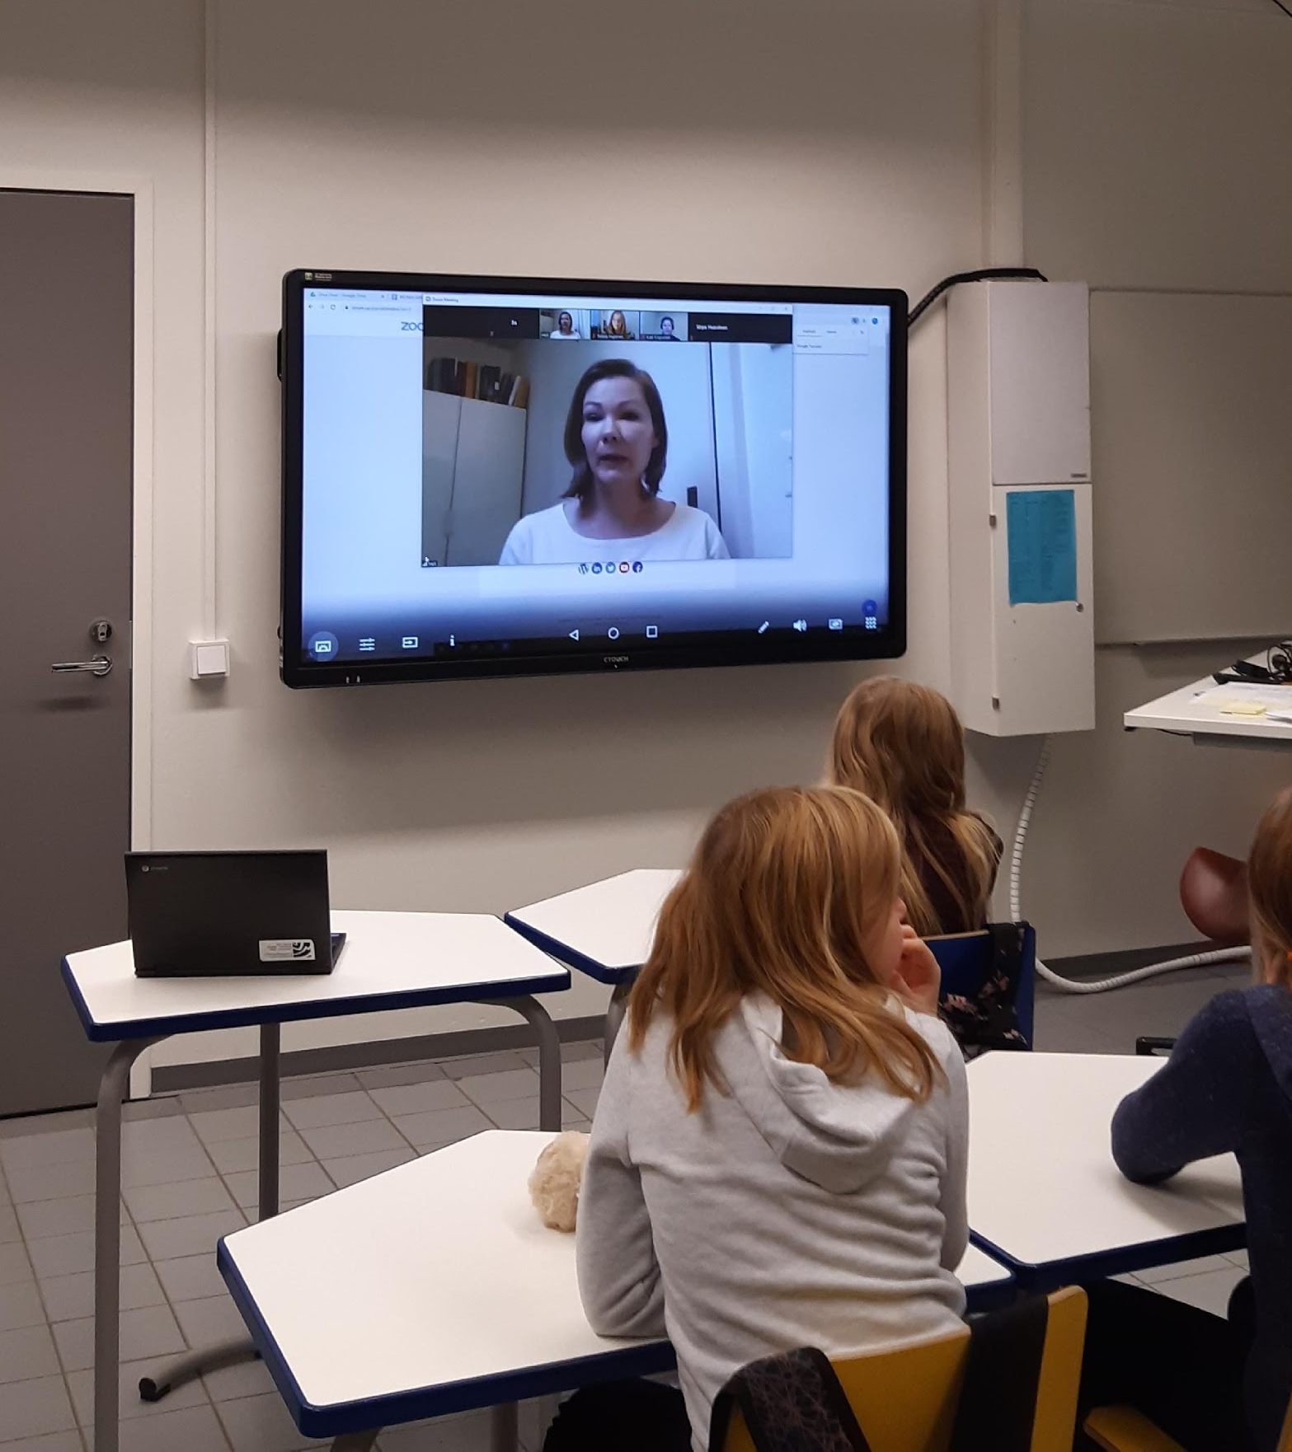
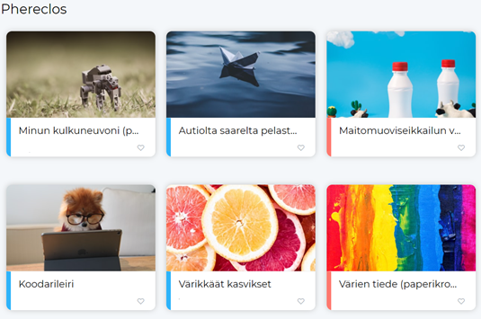
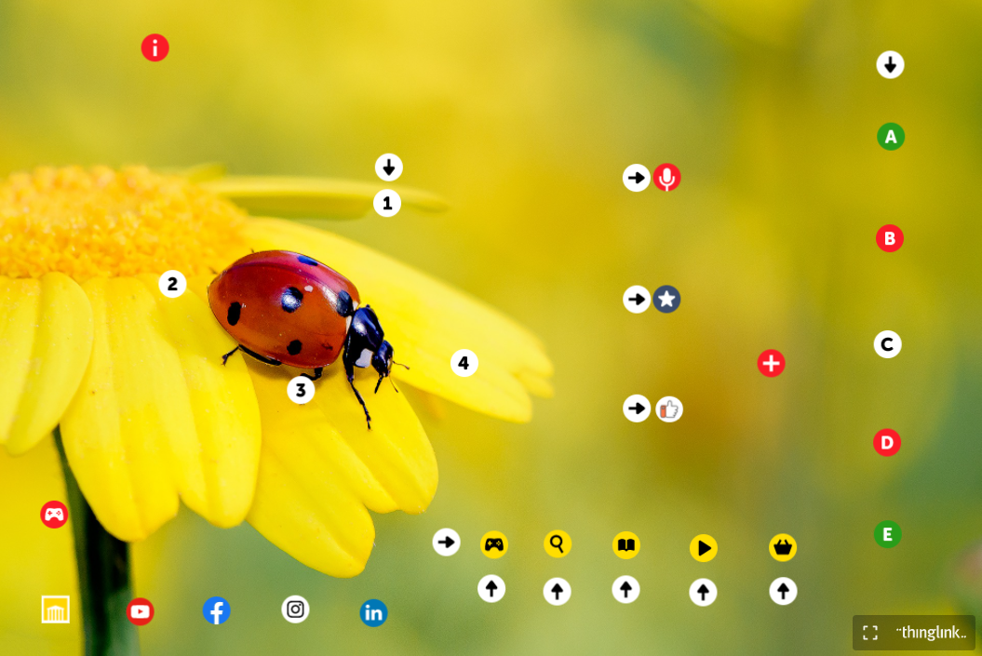
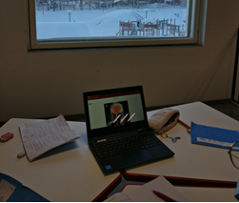
Co-creating … piloting … sharing … developing … virtual science clubs, online training & pedagogical ideas
#LEC
Kuopio Finland

Slide 19
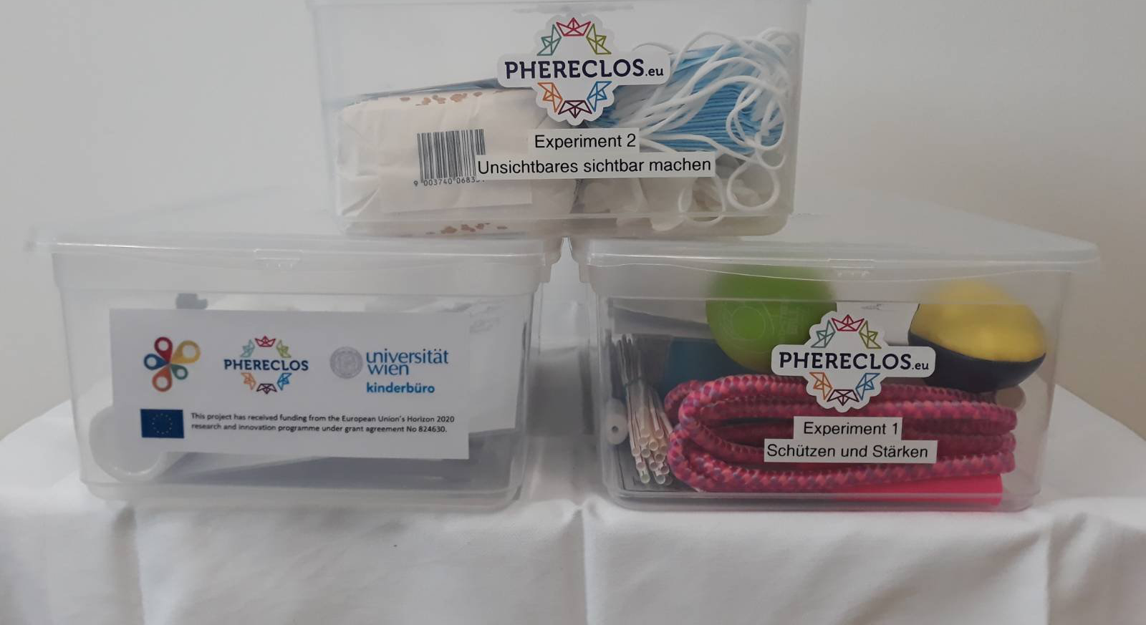
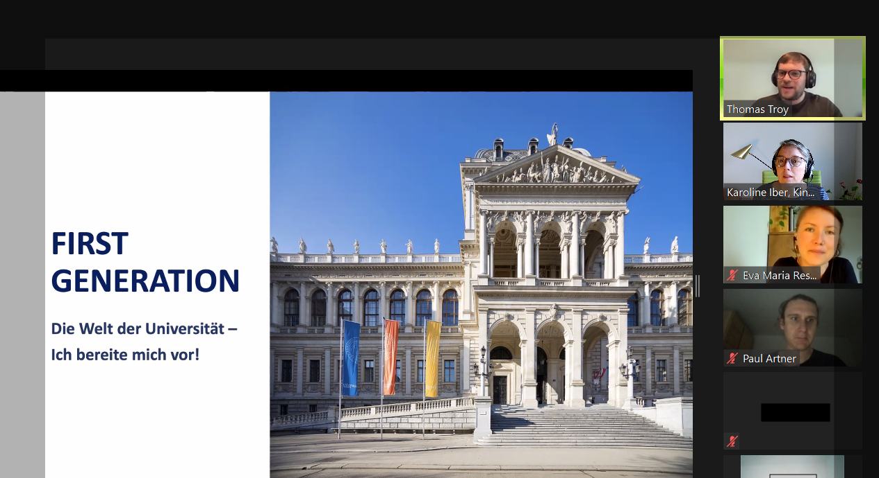
#LEC
Vienna Austria
#LEC
Trieste
Italy
connect the Bildungsgrätzl as a school network and the Vienna Children’s University as a university network
develop or, respectively, continue the development of a shared strategy for open schooling
enable a mutual exchange of knowledge, starting from primary education until the tertiary sector
their challenge is to be inclusive; including not only the one or two organisations per Bildungsgrätzl, but include the whole community (institutions and people) living in the Bildungsgrätzl
Every institution of the Bildungsgrätzl is free to choose if they want to participate in projects

Slide 20

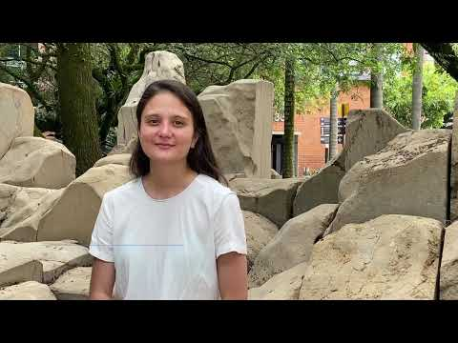
#LEC
Medellin Colombia
8 Teaching units
Teaching units are guides with activities that teachers can implement with students.
This teaching units were designed by the LEC partners. The topics are: Health, Culture, Gender equity, Youth, Social develop, Mobility, Social inclusion, Environment.
Implementation
15 schools are implementing the 8 teaching units
Podcast
A podcast that gather 8 voices that describes the 8 topics of the teaching units.
Manifesto
In this manifesto LEC partners give recommendations to politicians, schools and organizations to take part on open schooling.
Videos about co-creation
4 videos to give tips to schools to make co-creation: What is co-creation, from individual work to co-creation, design phases and methodologies, how to implement co-creation?
Videos about open schooling
4 videos to explain a few and important concepts for open schooling: What is open schooling, contextualizing learnings, expand the learning beyond the classroom, cultural change for the open schooling
Teacher training
During a week a group of 170 participants (teachers, parents, teacher training students) attendance workshops about: active learning, science capital, youth people, co-creation and open schooling
Co-creation methodology
A methodology to make co-creation for education has been described as a result of the LEC Medellín implementation.

Slide 21
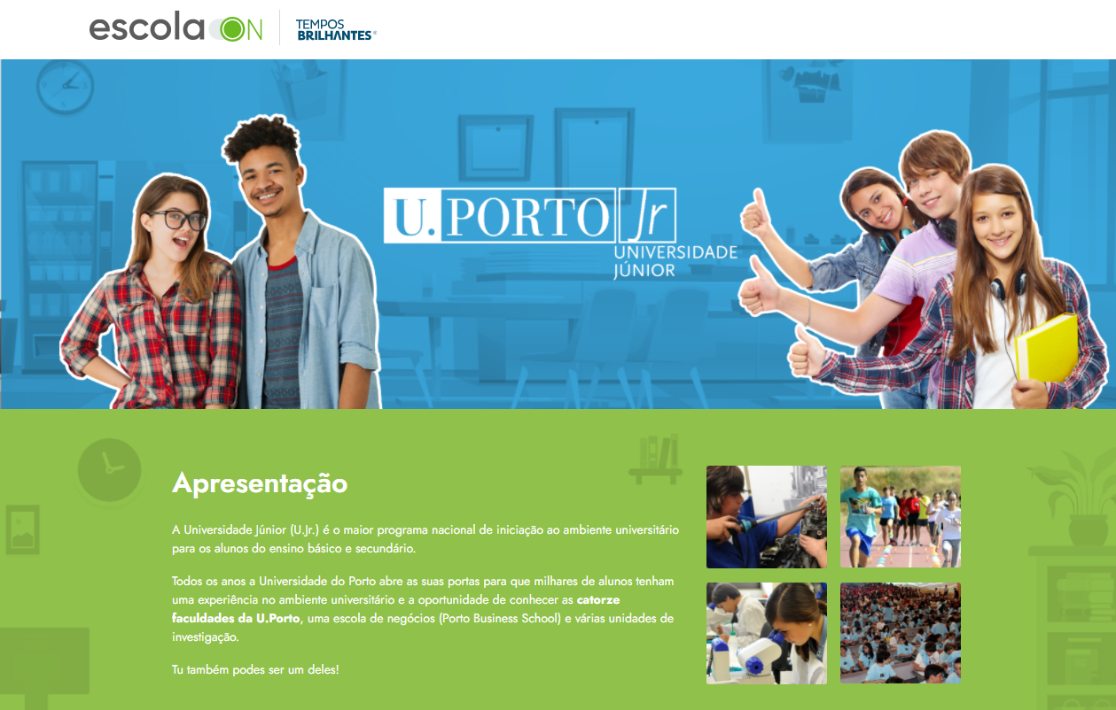
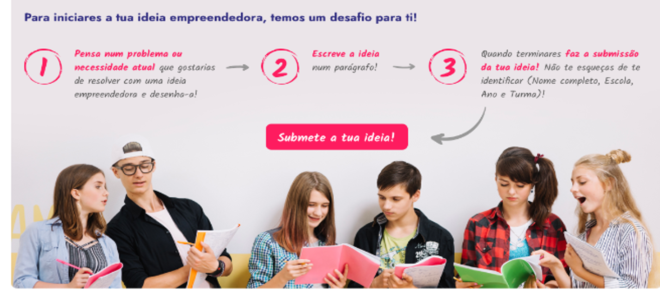
#LEC
Porto Portugal
#LEC
Trieste
Italy
connections between the University of Porto, schools, students’ families and professionals. These different publics will be placed in the same ecosystem; built upon the expertise of Junior University.
Providing students with challenging non-formal educational experiences to develop skills beyond the school.
Students will present their ideas and questions based on their own perspectives and real needs of the community outside the schools, and will draw solutions through business ideas.
Linking STEAM & Entrepreneurship

Slide 22
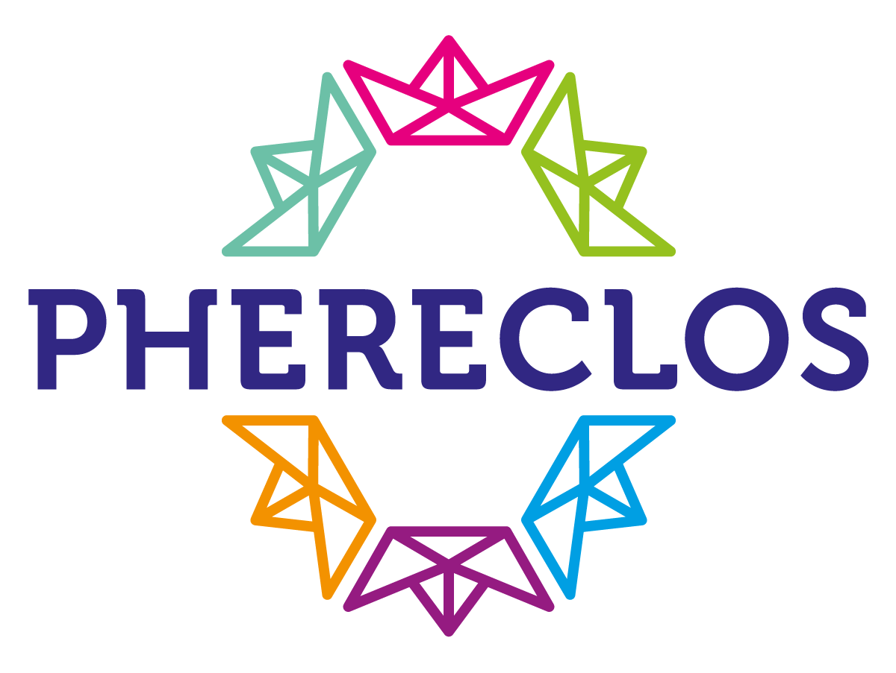
The Sustainability Planning Process
3 Steps to Increase Your Sustainability
    Assess
      Diagnose your current sustainability capacity
      Identify areas for developing sustainability strategies
      Clarify your sustainability goals
    Plan
      Prioritize which parts of your program you would save
      if funding was cut
      Specify concrete sustainability strategies
    Implement
SPIDERS WEB
WORST CASE
STRATEGIES => ACTION PLAN
‹#›
Notes:
‹#›

Slide 23
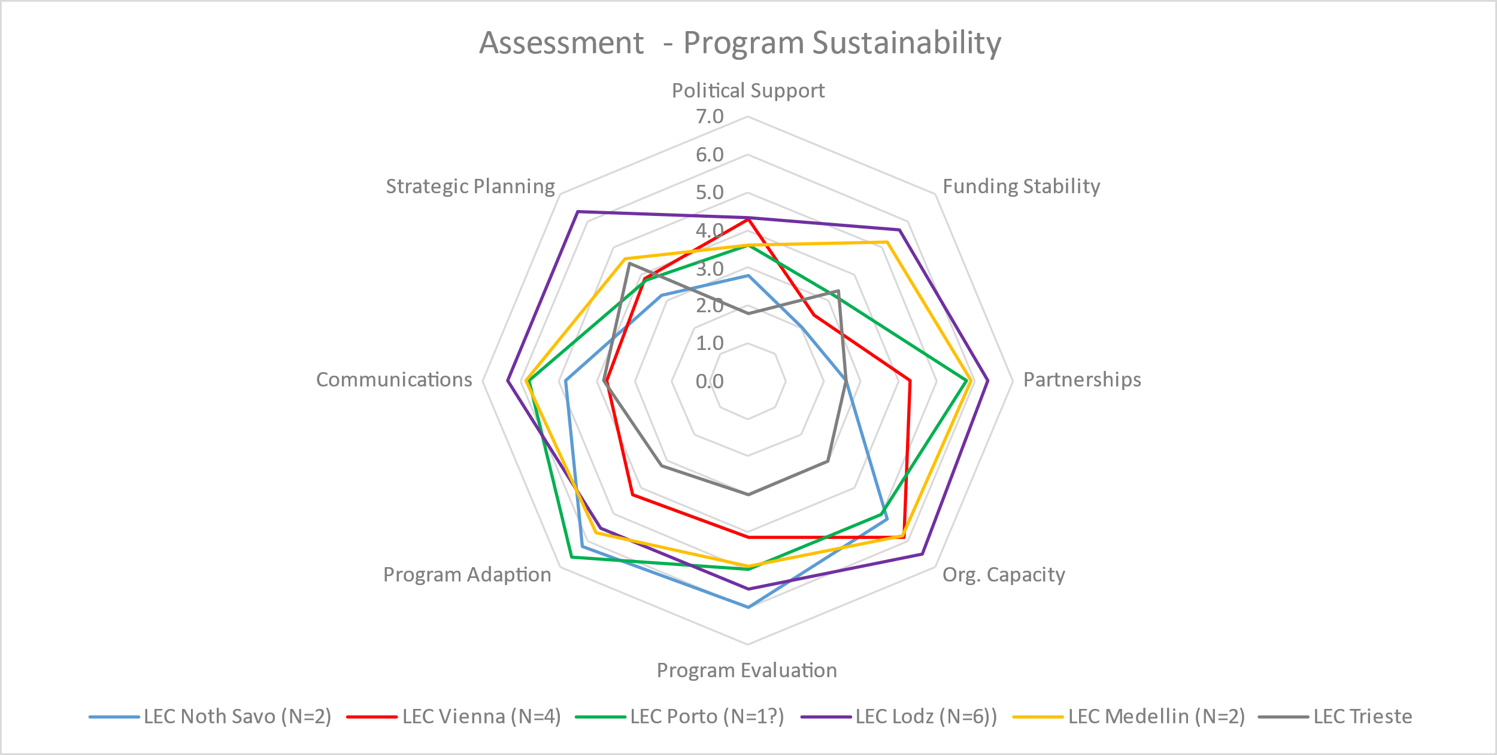
Assessment: Spiders WEB

Slide 24
Trans-National Educational Mentoring Partnership (TEMPS)
These partnerships aim to create a STEAM-related mentoring programmes between education providers from different countries, which have different levels of experience in Open Schooling.
The TEMPS are intended to amplify the individual and institutional learning generated about capabilities and effectiveness of Open Schooling models, notably from within the LECs and share it with a wider range of experts and practitioners. In return, it shall contribute to the accumulation of further insights about practical implementation of collaboration schemes in Open Schooling
Portugal & Spain
Austria, Spain, The Netherlands
Germany & Greece
Ireland, Poland, Spain
Romania & Spain
Greece & Spain
Denmark & Latvia
Romania & Turkey
Hungary & Serbia
Italy & Romania
https://www.phereclos.eu/media-centre

Slide 25
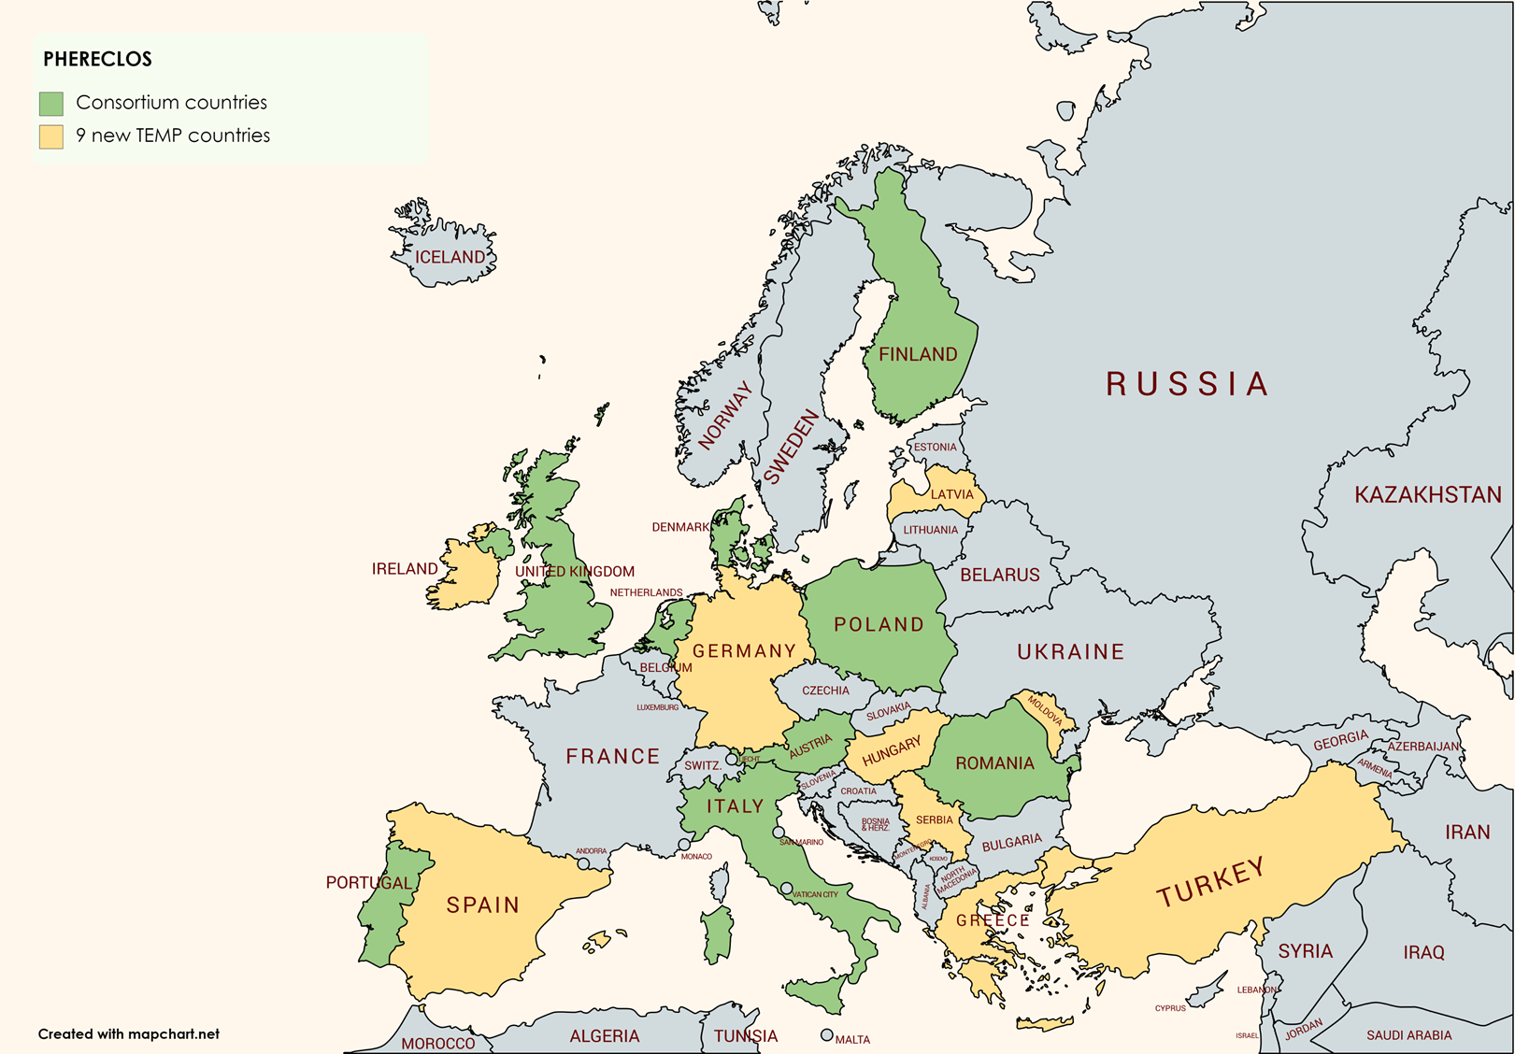
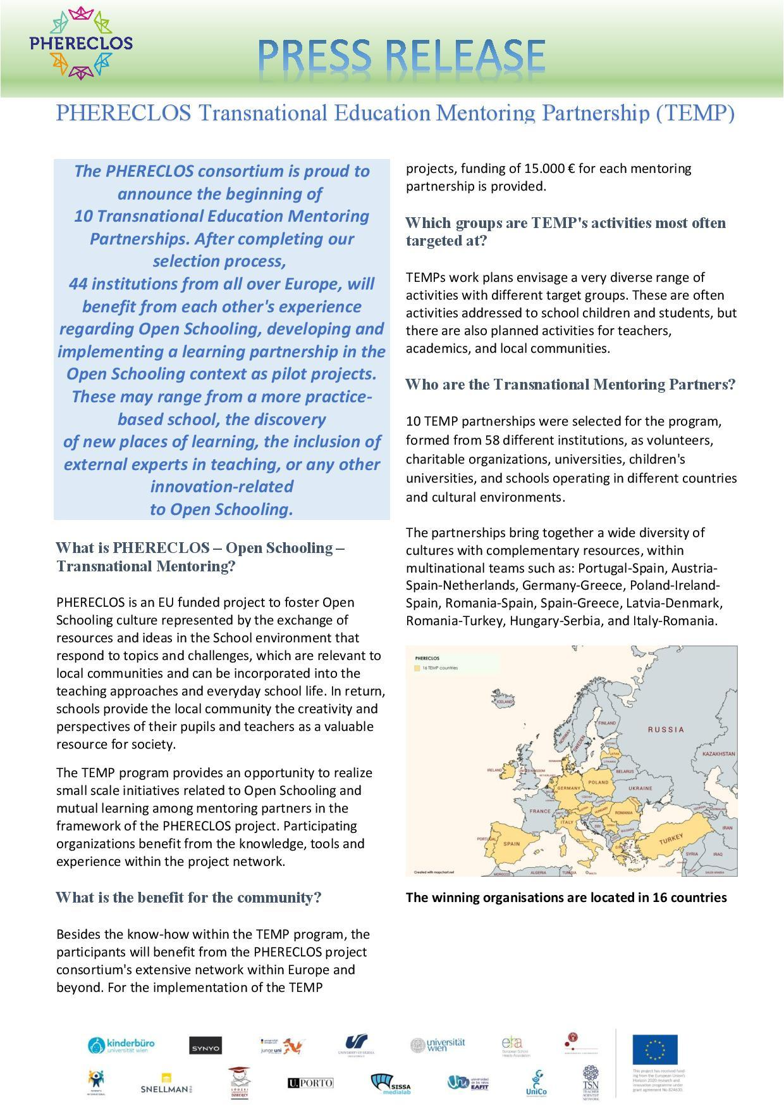
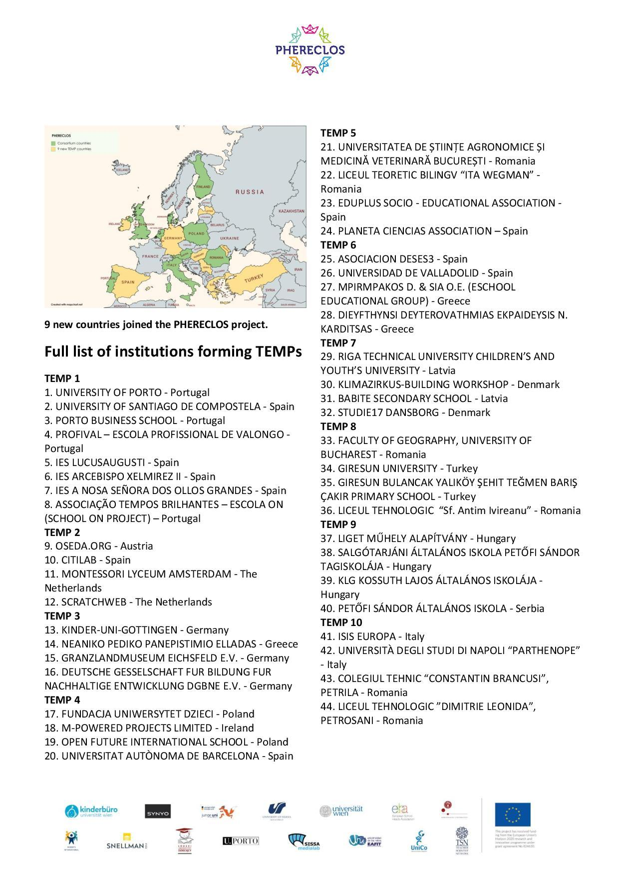
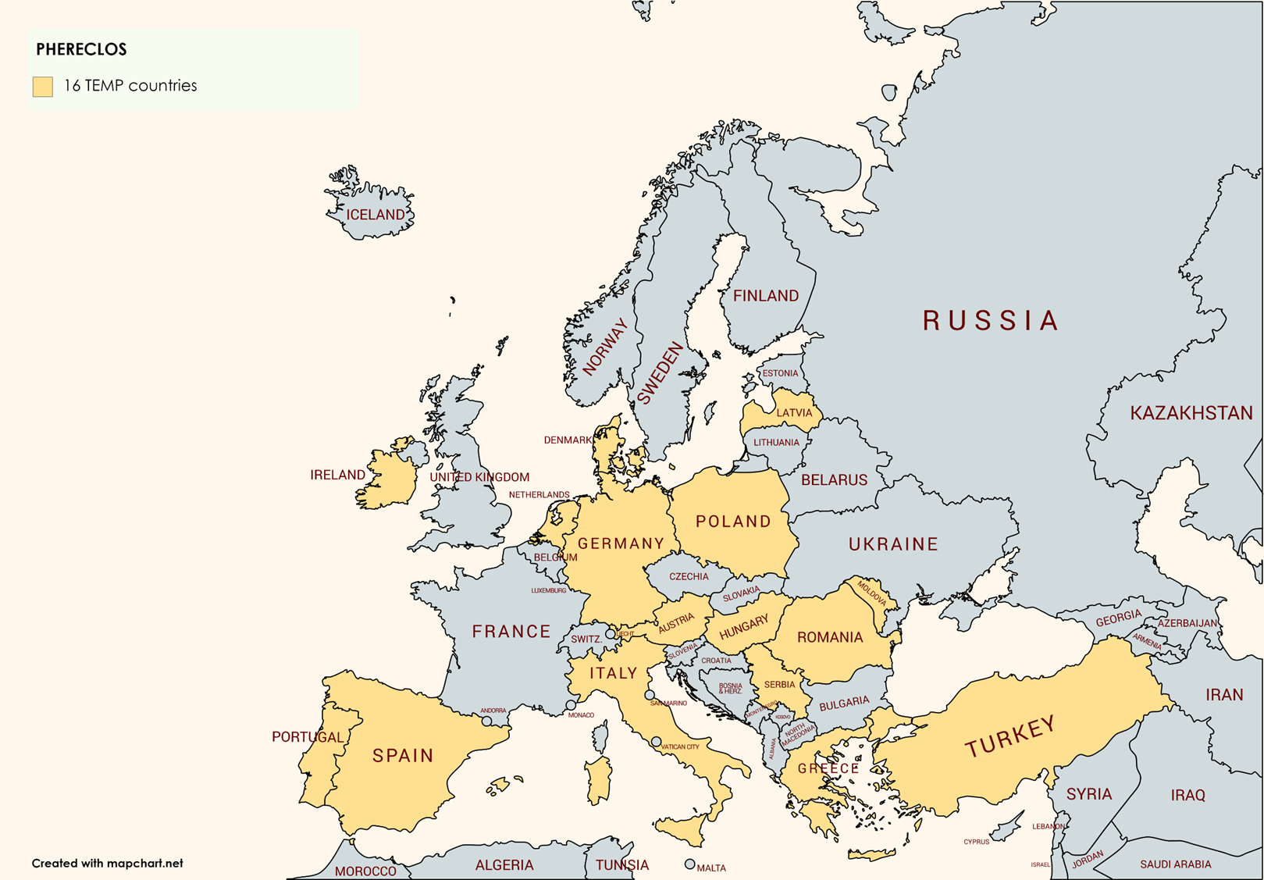

Slide 26

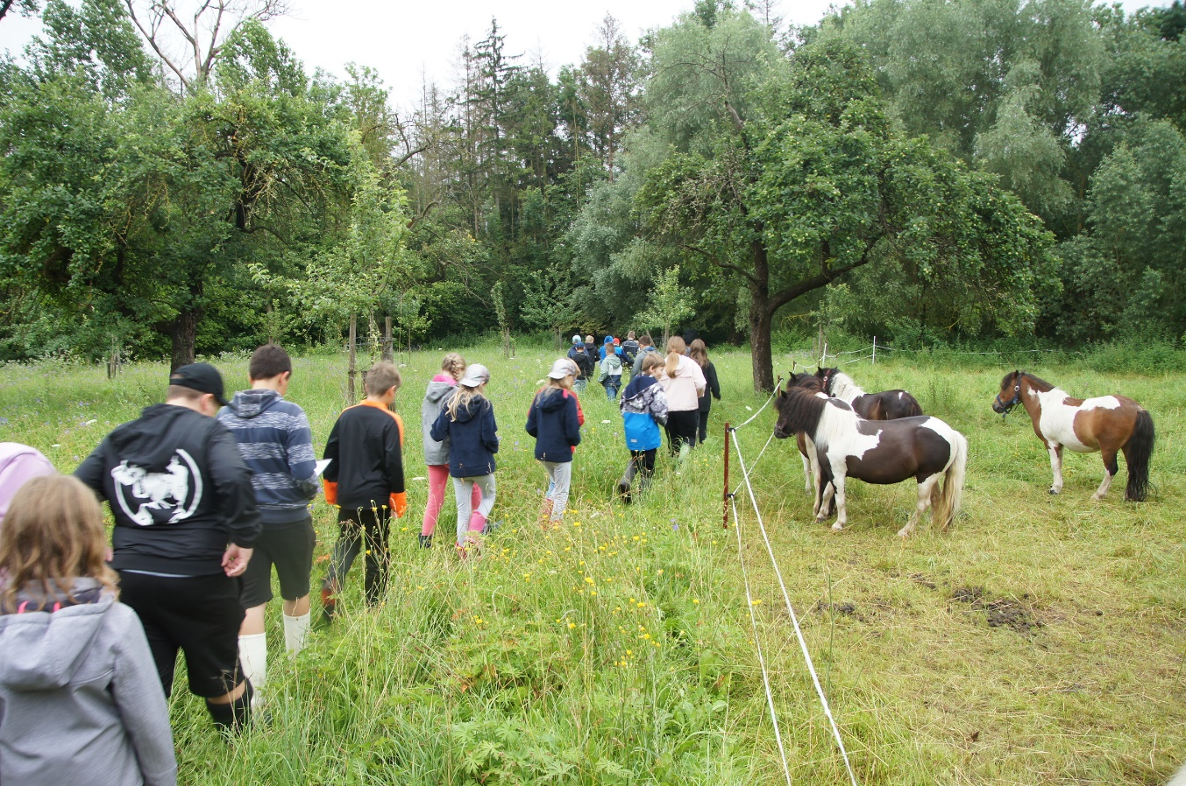
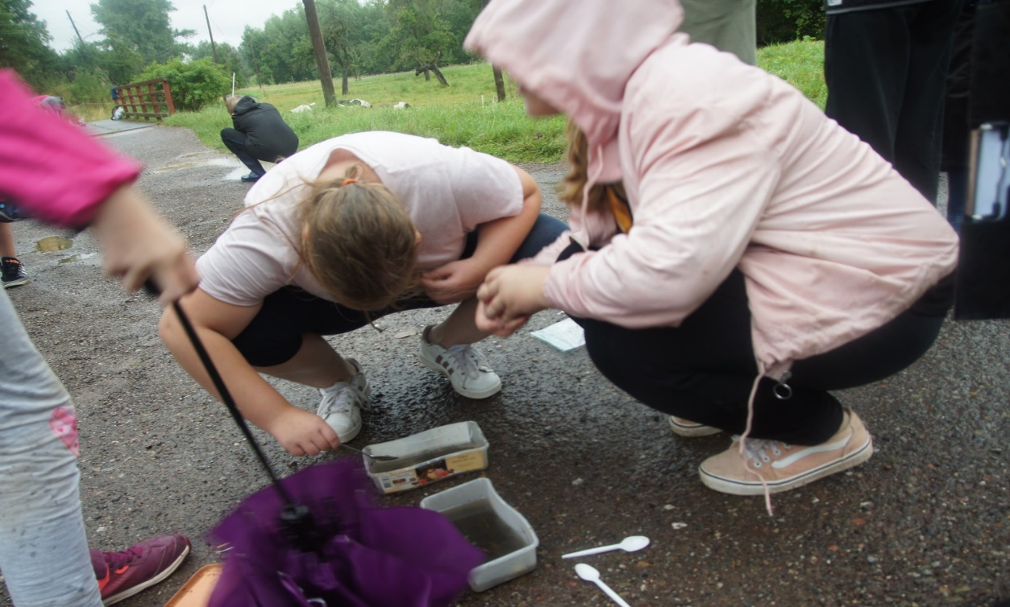
PHERECLOS TEMP 3
Children aged 10 – 14 years in this TEMP learn about the sustainability goals. They discover in a playful way, analyse theoretically, and get in practical touch with the conflicts coming along with the SDGs and their realization.
To achieve this goal, two children's universities, a political and ecological education institution and an NGO for education for sustainability will work together, combining humanities and social science, natural science and socio-cultural aspects
Includes 4 institutions:
KINDER-UNI-GOTTINGEN - Germany,
NEANIKO PEDIKO PANEPISTIMIO ELLADAS - Greece,
GRANZLANDMUSEUM EICHSFELD E.V. - Germany, and
DEUTSCHE GESSELSCHAFT FUR BILDUNG FUR NACHHALTIGE ENTWICKLUNG DGBNE E.V. - Germany.

Slide 27
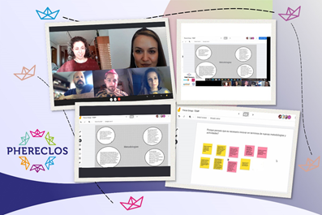
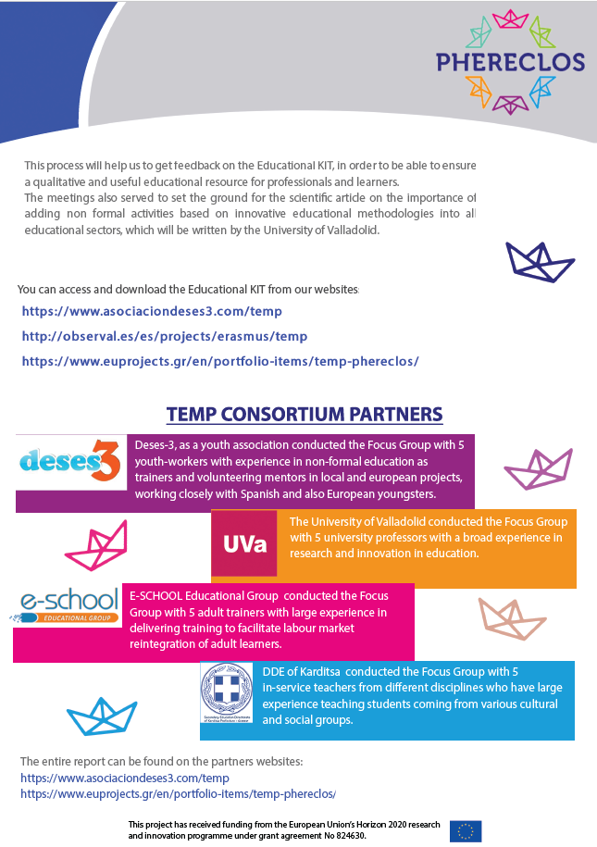
The aim of TEMP 6 is to create a long lasting network of educational actors that share experiences and best practices of using the innovative educational methodology in working with different targets groups (children, youth, adults)
An Educational Guide came as a result of the TEMP (Transnational Education Mentoring Partnership) in the framework of PHERECLOS project.
The Guide aims at providing an overview of innovative methodologies and their appliance in different educational fields, in which partners are active and contains a first theoretical part, in which are explained the following methodologies and the tips on how to implement them according to each educational sector
• Personalized Learning
• Project-Based Learning (PBL)
• Place-Based Education
• Real-World Learning
• Formative Assessment
includes 4 institutions:
ASOCIACION DESES3 - Spain,
UNIVERSIDAD DE VALLADOLID - Spain,
MPIRMPAKOS D. & SIA O.E. (E-SCHOOL EDUCATIONAL GROUP) - GR
DIEYFTHYNSI DEYTEROVATHMIAS EKPAIDEYSIS N. KARDITSAS - Greece.
PHERECLOS TEMP 6

Slide 28
OS Together
There are currently a number of funded initiatives under Horizon 2020 which focus upon Open Schooling.
To maximise the benefits to all and increase impact, a new collaboration has been developed, representing the collective of the 7 ‘sister projects’ - “OS Together”.
common newsletters,
common Twitter account (https://twitter.com/OStogether)
common Facebook page (https://www.facebook.com/ostogether )
Inspiration Sessions
This project has received funding from the European Union’s Horizon 2020 research and innovation programme under grant agreement No 824630.

Slide 29




Keeping in Touch ... much more to come!
https://www.phereclos.eu/community
kinderbuero@univie.ac.at
@PhereclosE
PhereclosEU

Slide 30
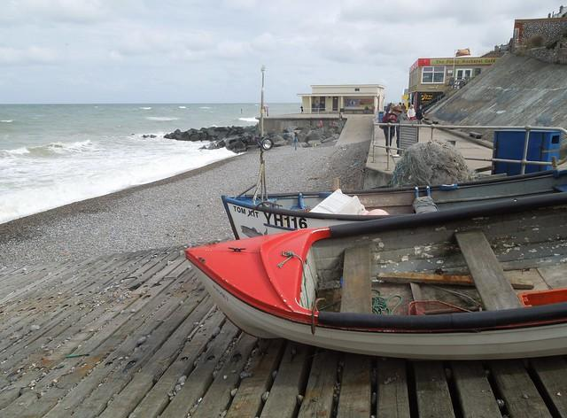
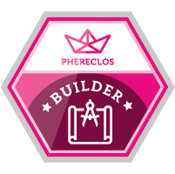
All Aboard!
https://www.phereclos.eu/community
phil.smith@nbi.ac.uk
laura.cristea@unico.org.ro

